Slide 1


Beyond Better Actions:
What Generalist Physical
Agents Still Need
Soujanya Poria
DeCLaRe Lab · Nanyang Technological University

Slide 2
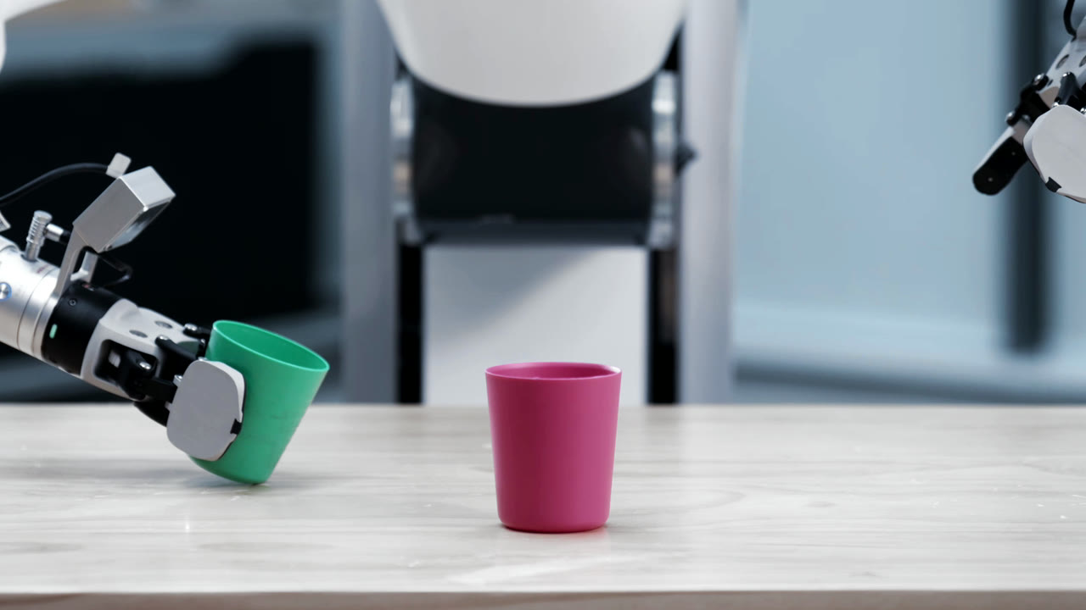
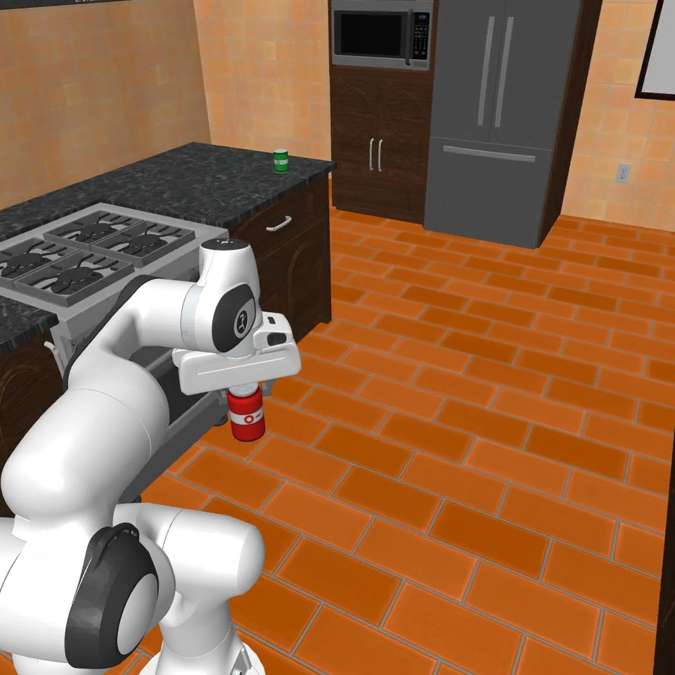
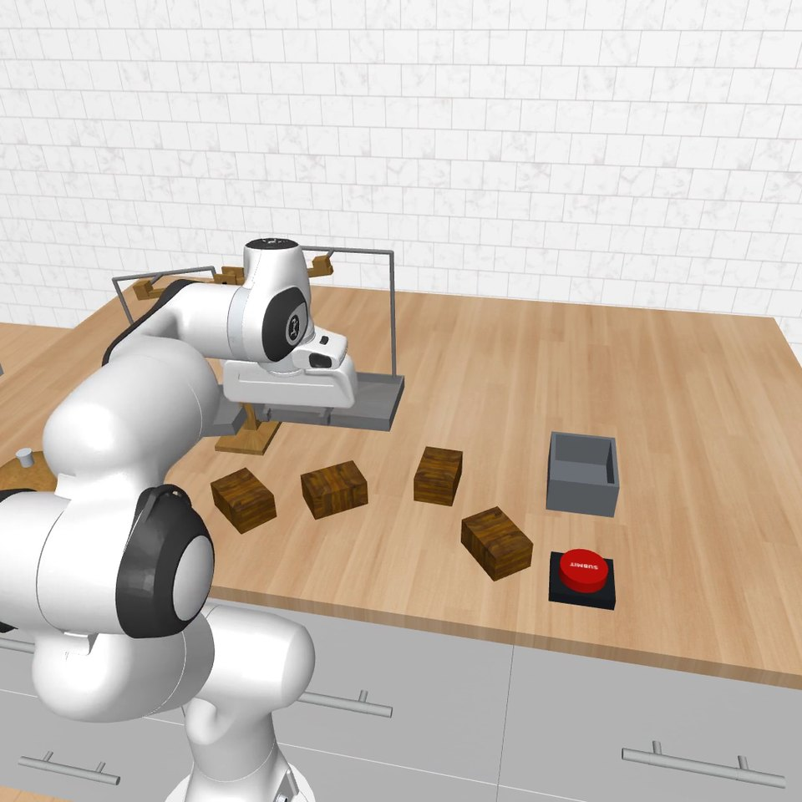
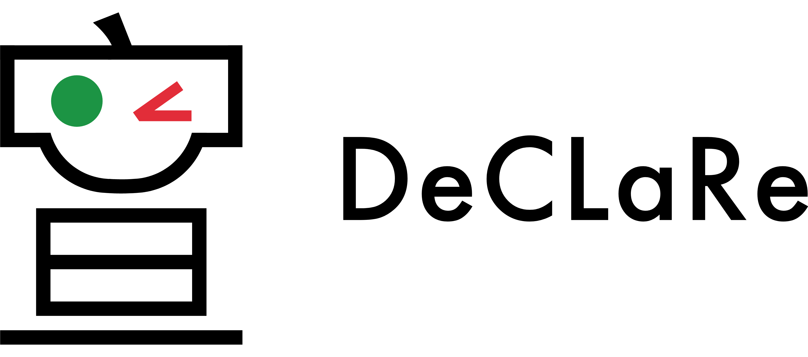
A generalist robot must handle many tasks
Stack the cups
Find hidden objects
Find the heavier parcel
GE-Act 2.0
RoboQuest · Search Room
RoboQuest · Odd Parcel

Slide 3
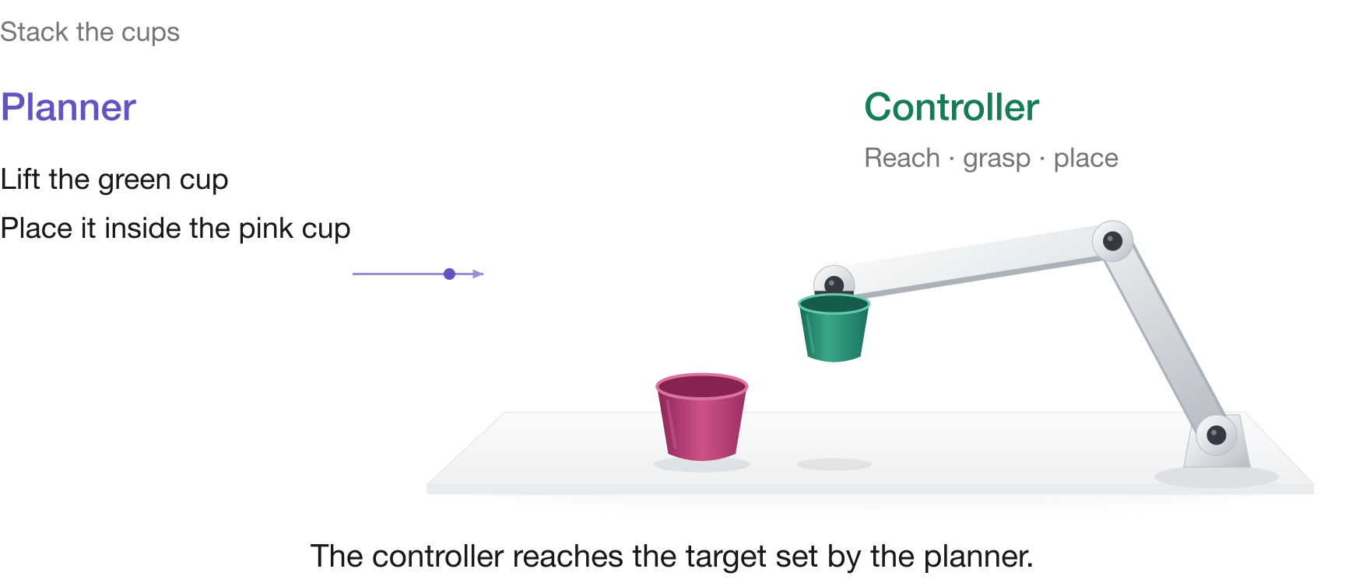
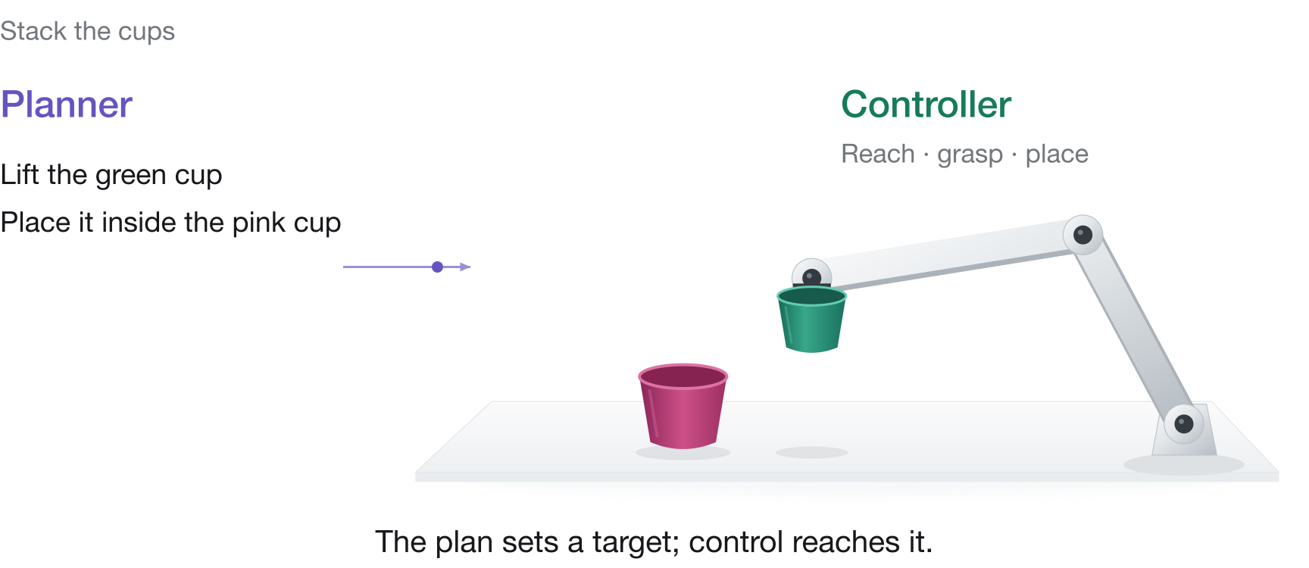
Every task needs planning and control

Slide 4
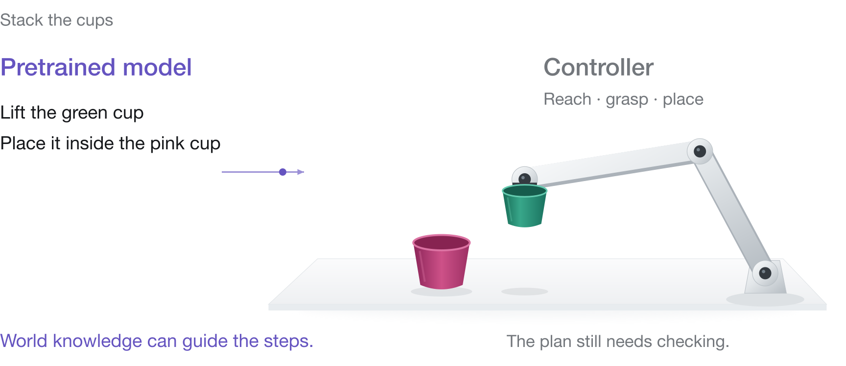
Pretrained knowledge can supply the plan

Slide 5
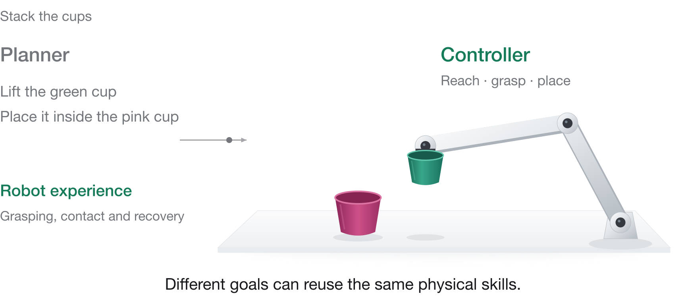
Robot data can focus on reaching the target

Slide 6
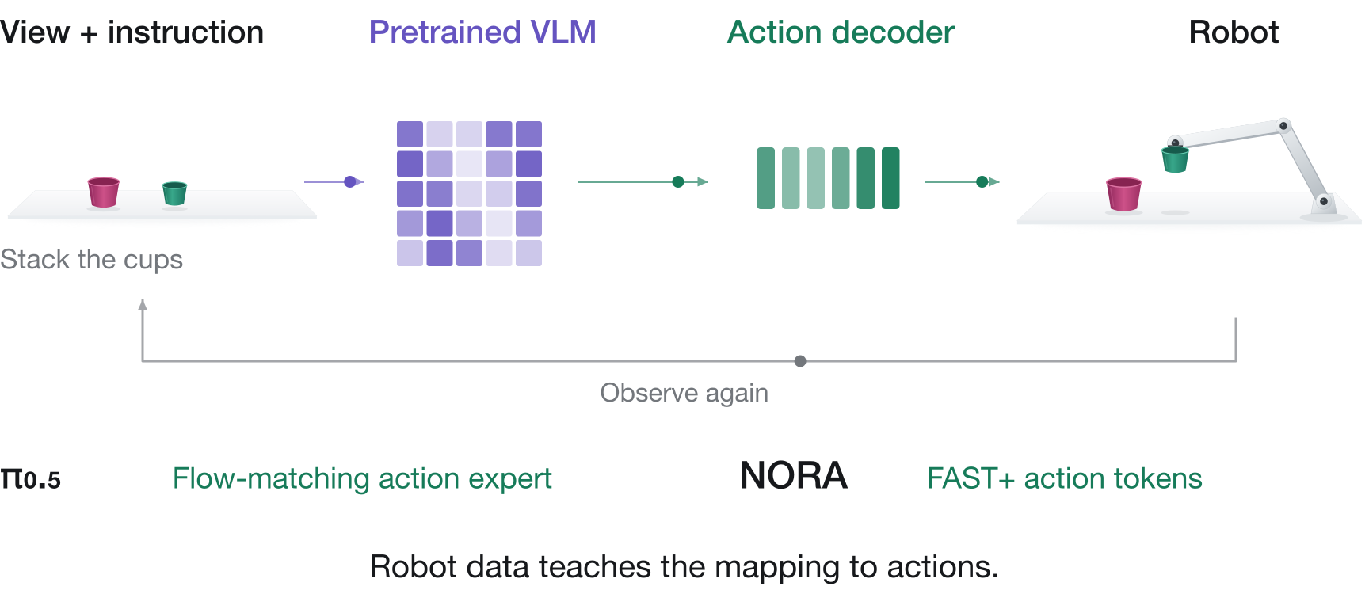
Vision-language-action models

Slide 7
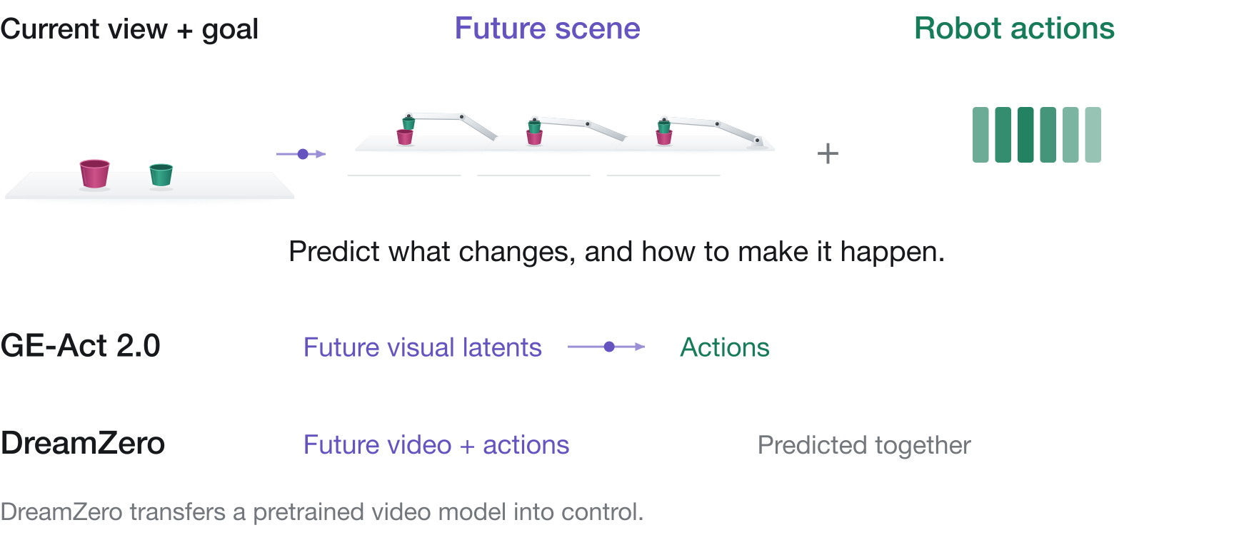
World action models

Slide 8
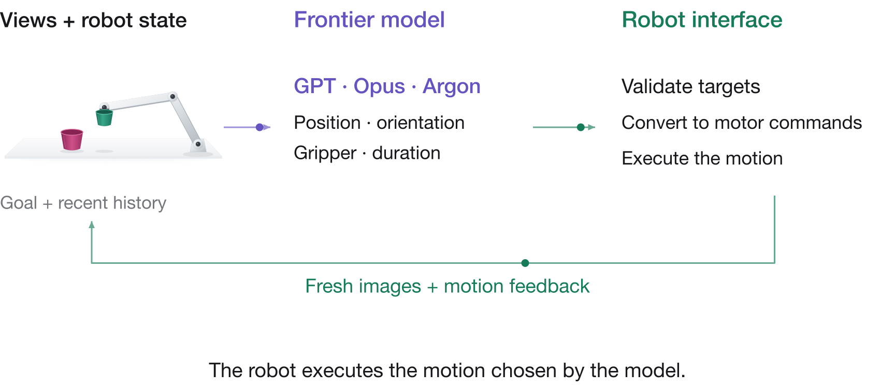
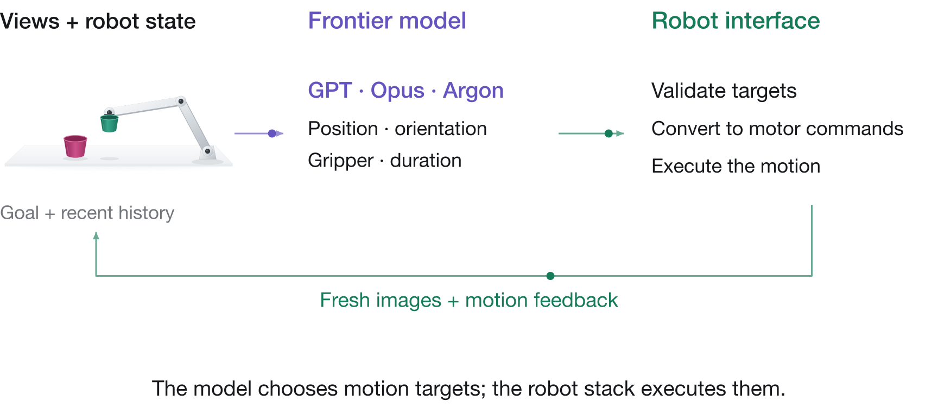
Frontier models in a robot harness

Slide 9
Direct robot control in simulation
RoboDojo
RoboQuest
GPT-6 Astra
Success rate (%)
22.48%
Average success

Slide 10
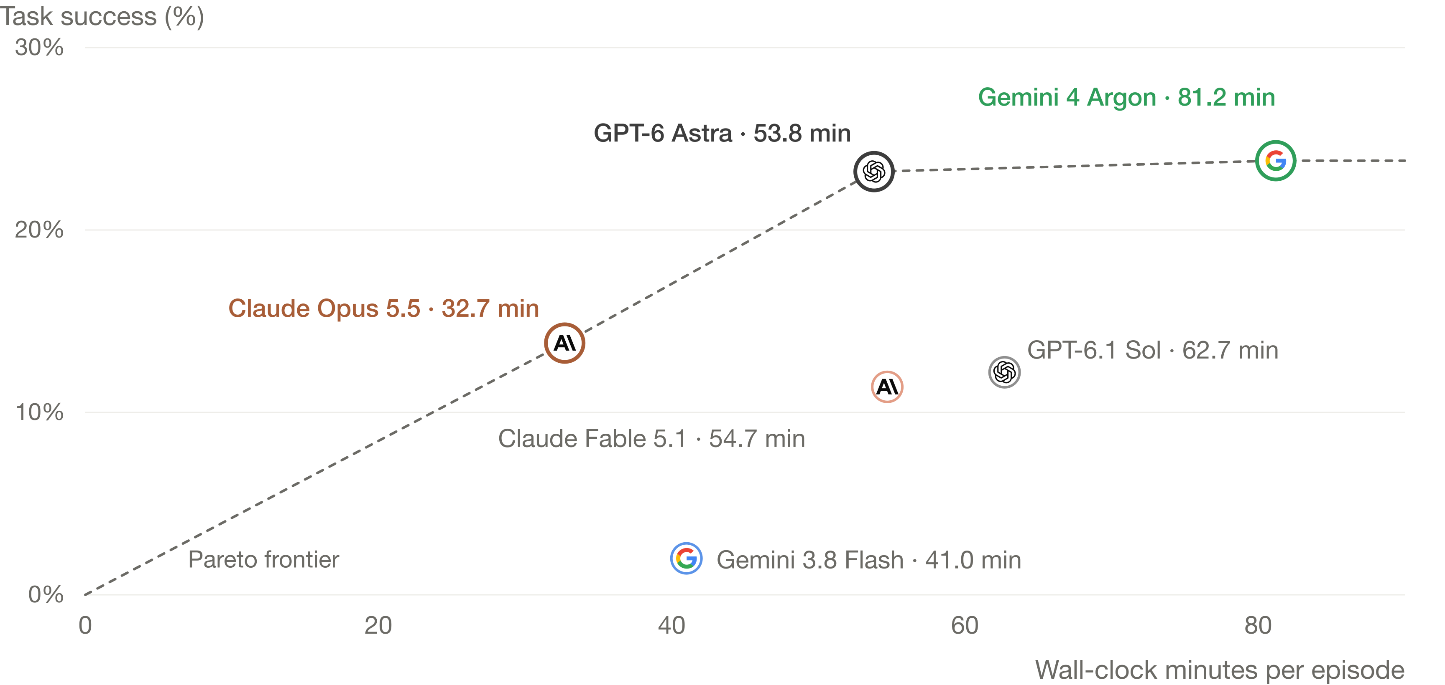
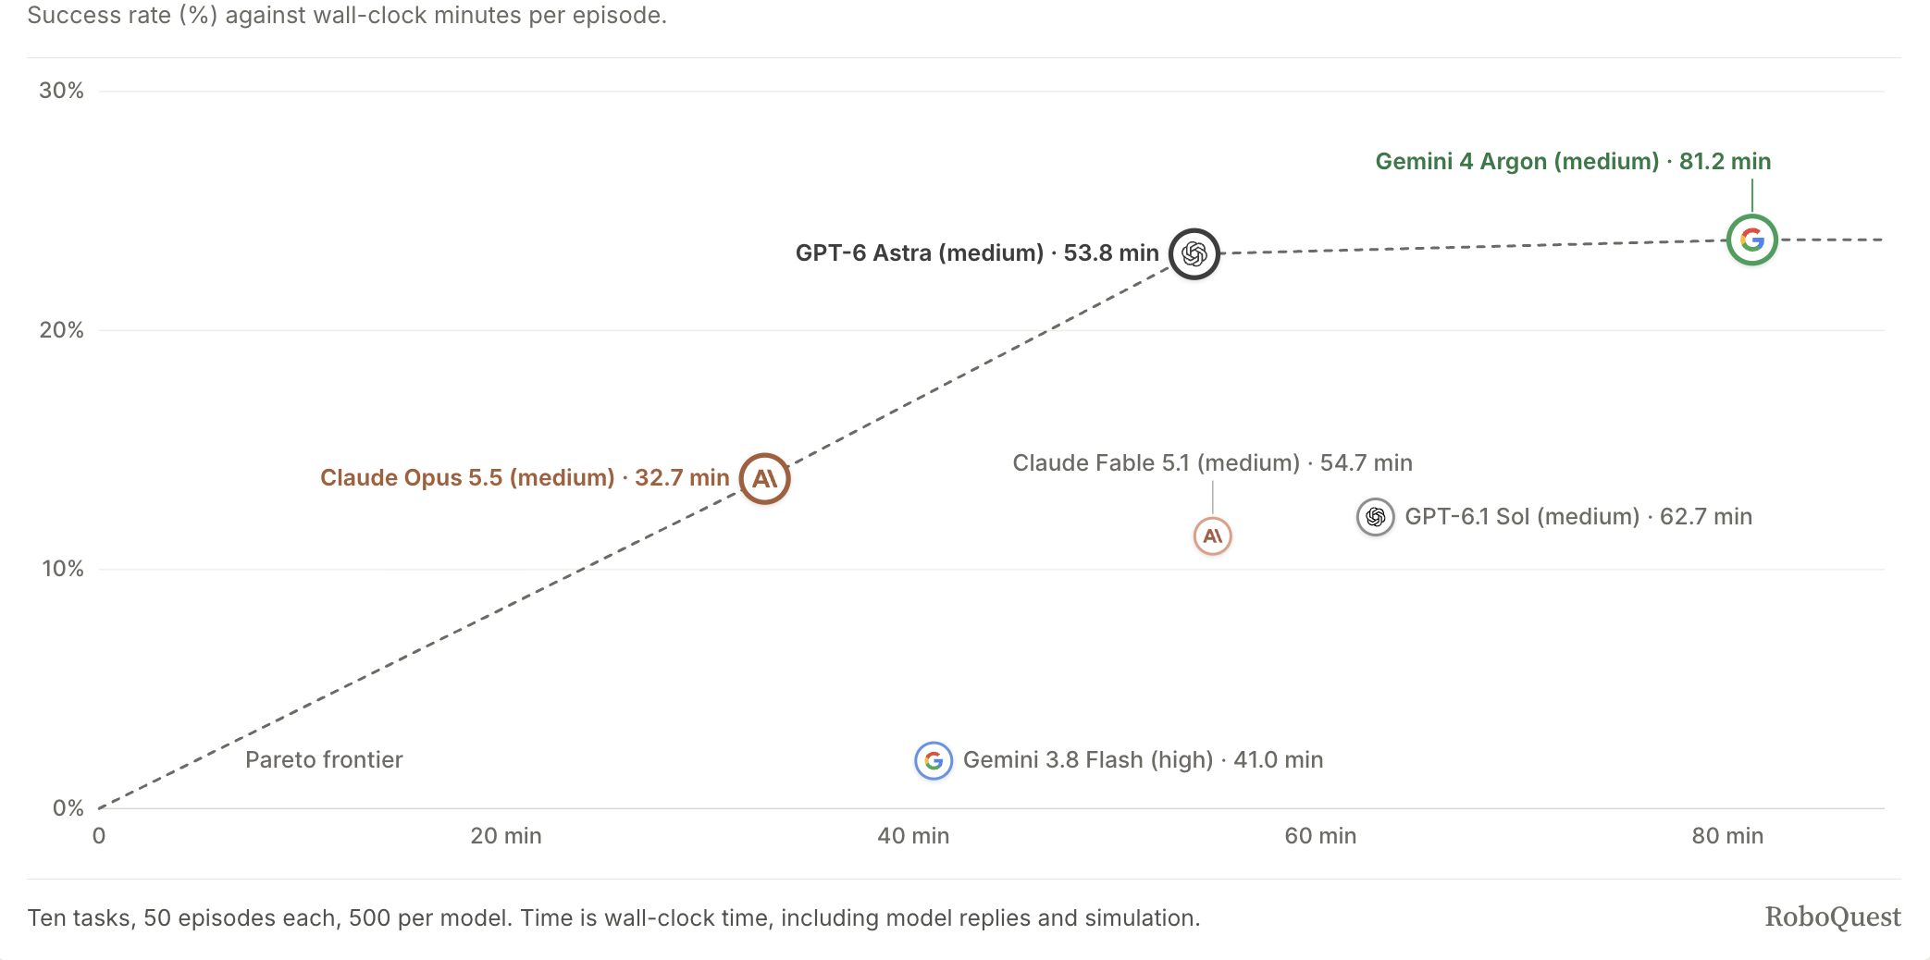
RoboQuest: success and time

Slide 11
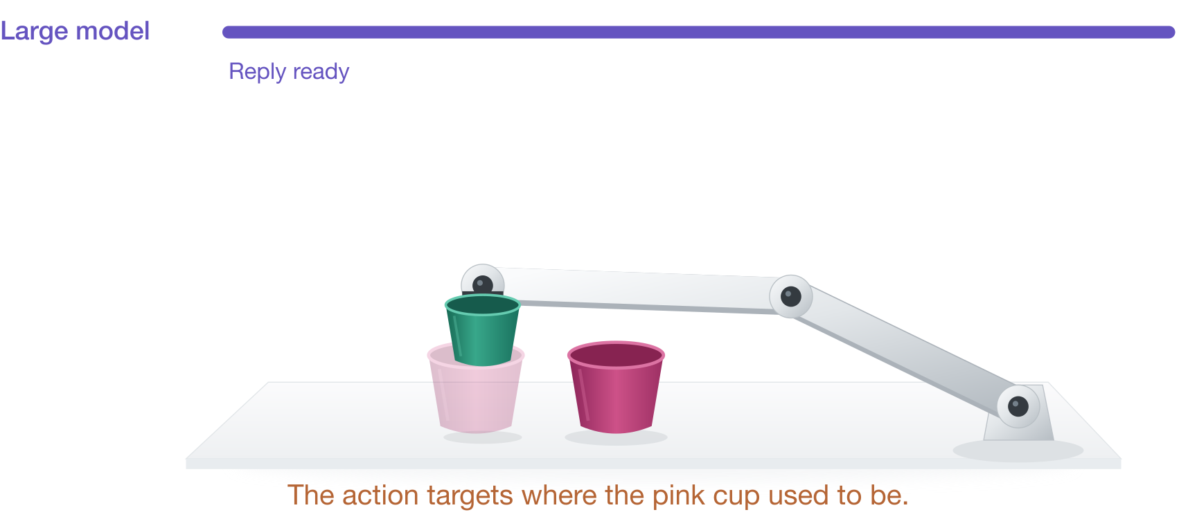
Waiting for each model reply delays control

Slide 12
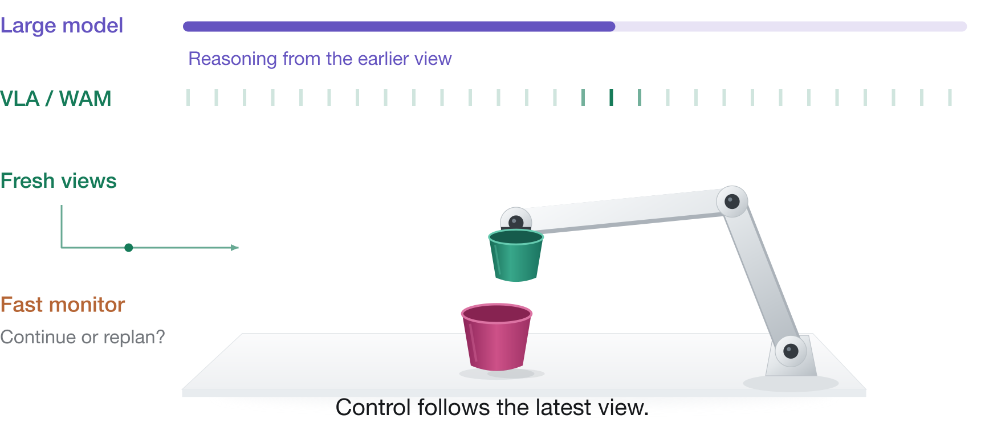
Control runs while the large model reasons

Slide 13
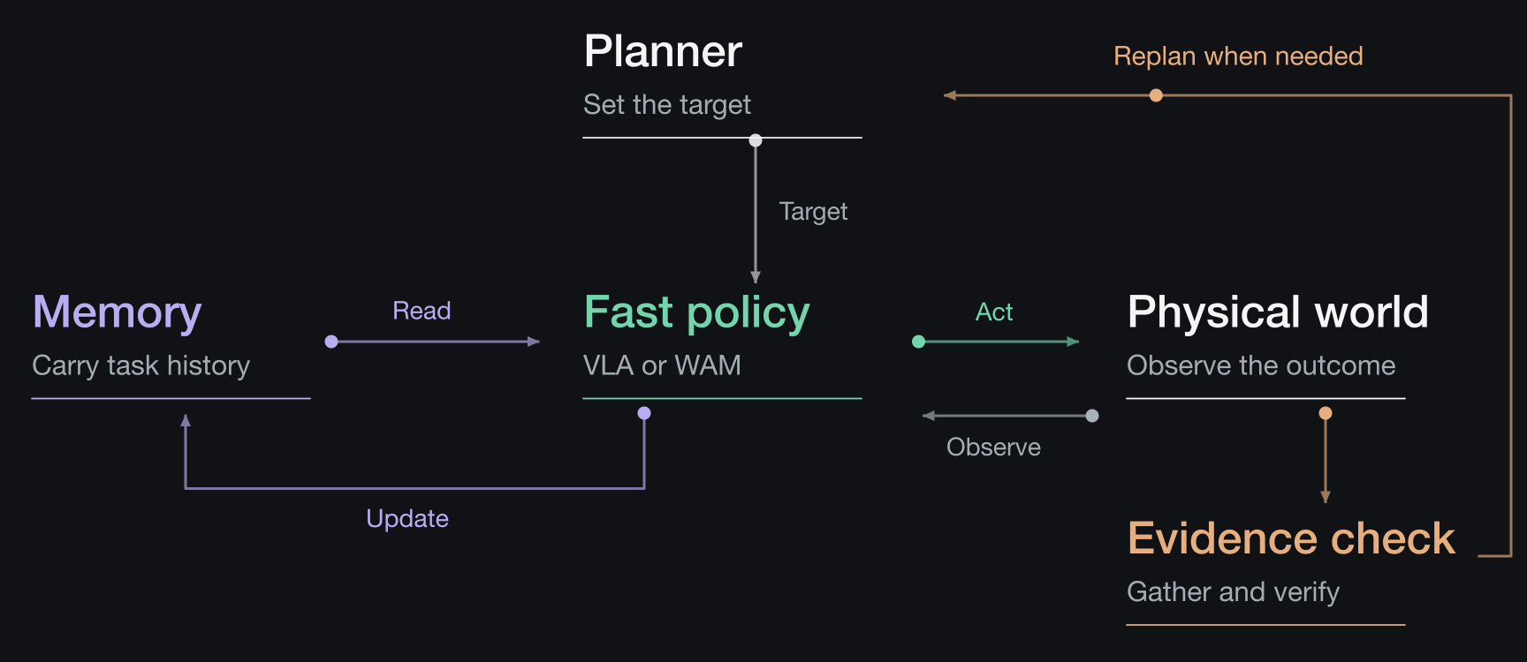
A possible physical-agent harness

Slide 14
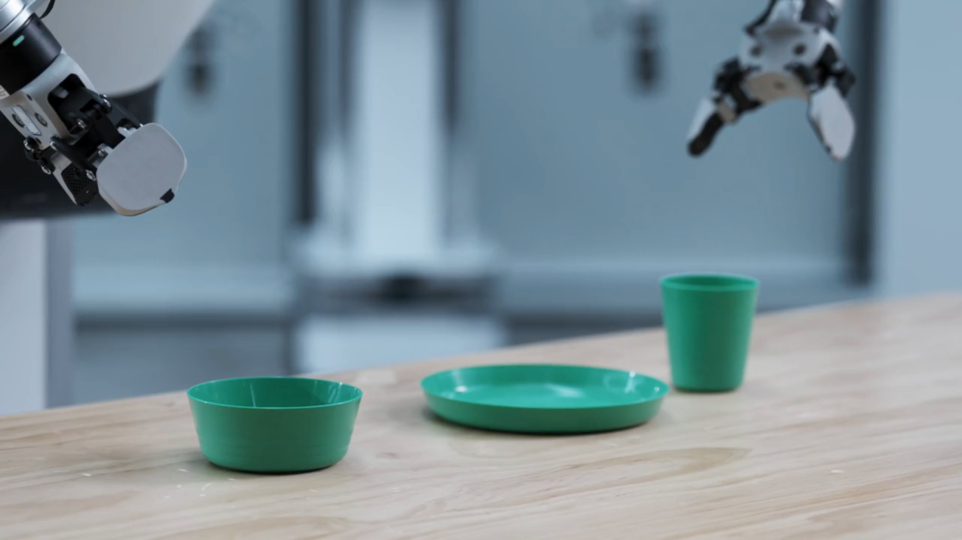
GE-Act 2.0
Learning physical control

Slide 15
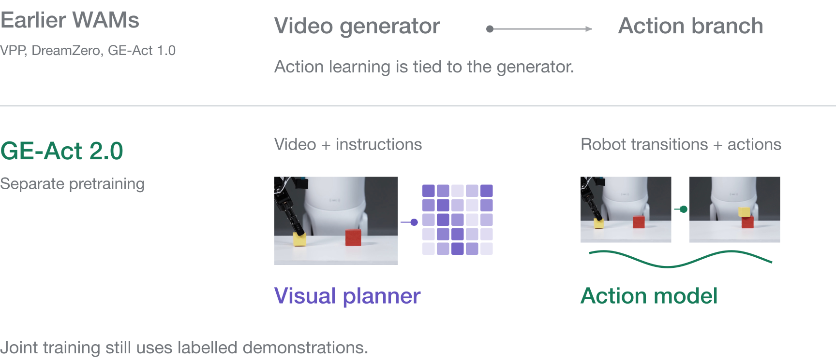
Learning from instruction-free robot data
Play, failures and rollouts

Slide 16
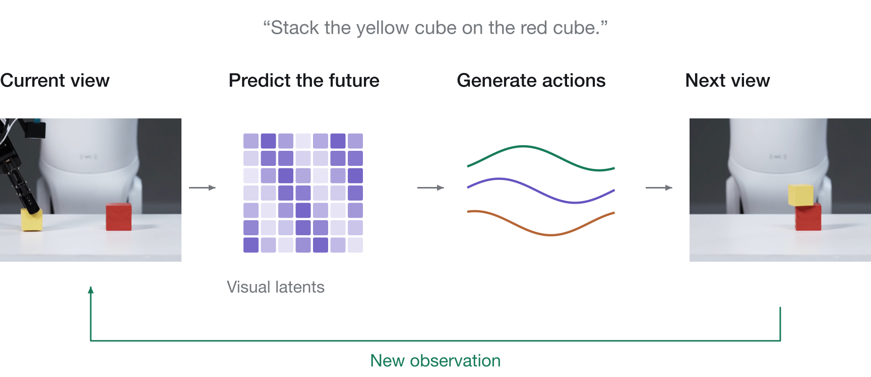
Predict the scene, then generate actions

Slide 17
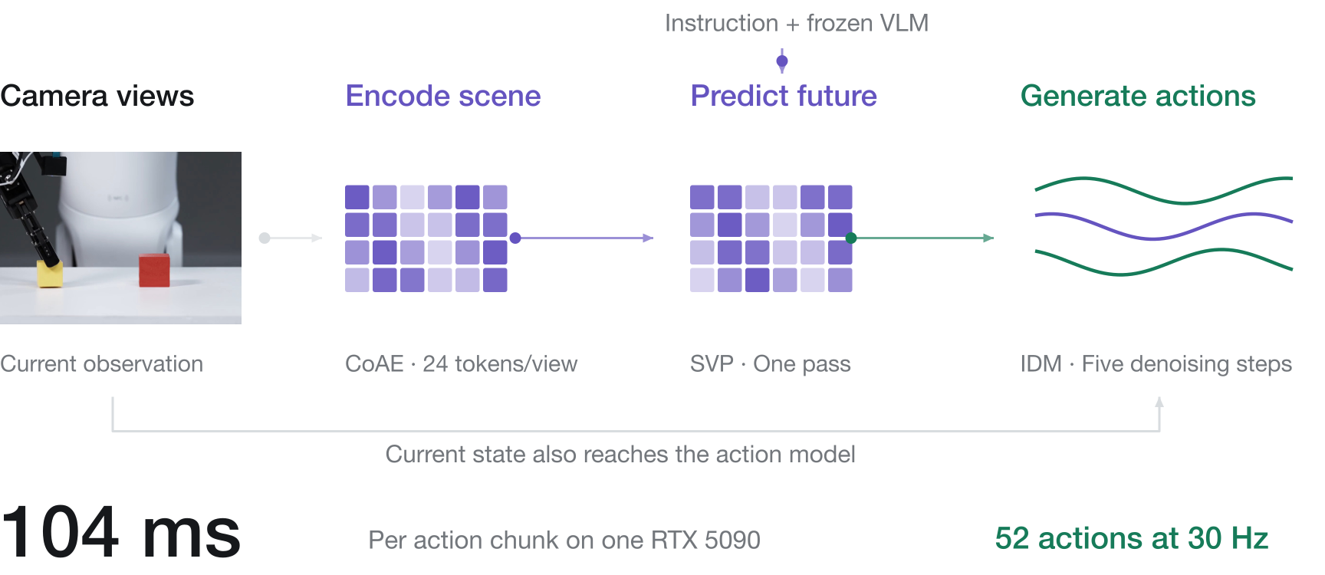
Inside GE-Act 2.0

Slide 18
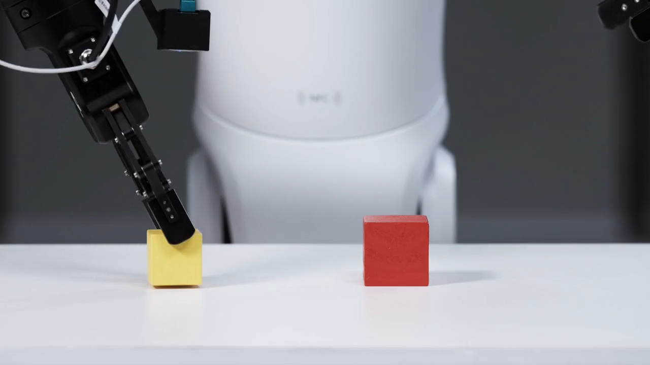
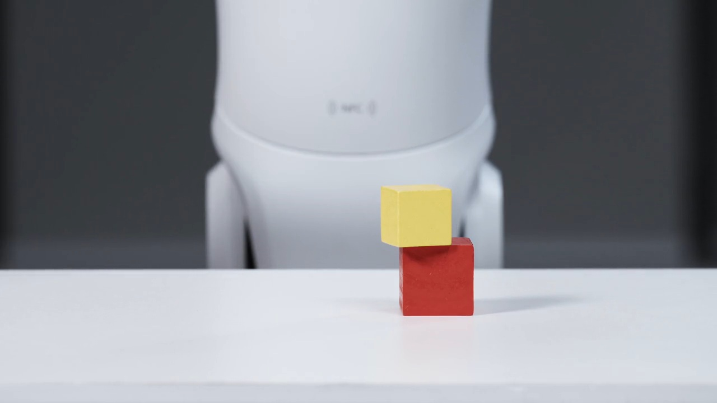
Learning from complementary data
Visual prediction
39,000 h
Video with instructions
Predict the future
Action recovery
32,000 h
Before + after
Recorded actions
Robot trajectories
No instruction required

Slide 19
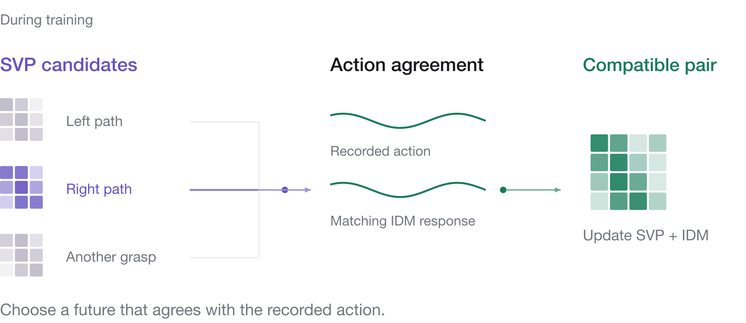
KASO aligns predicted futures with actions

Slide 20
Scaling improves control
Task success (%)

Slide 21
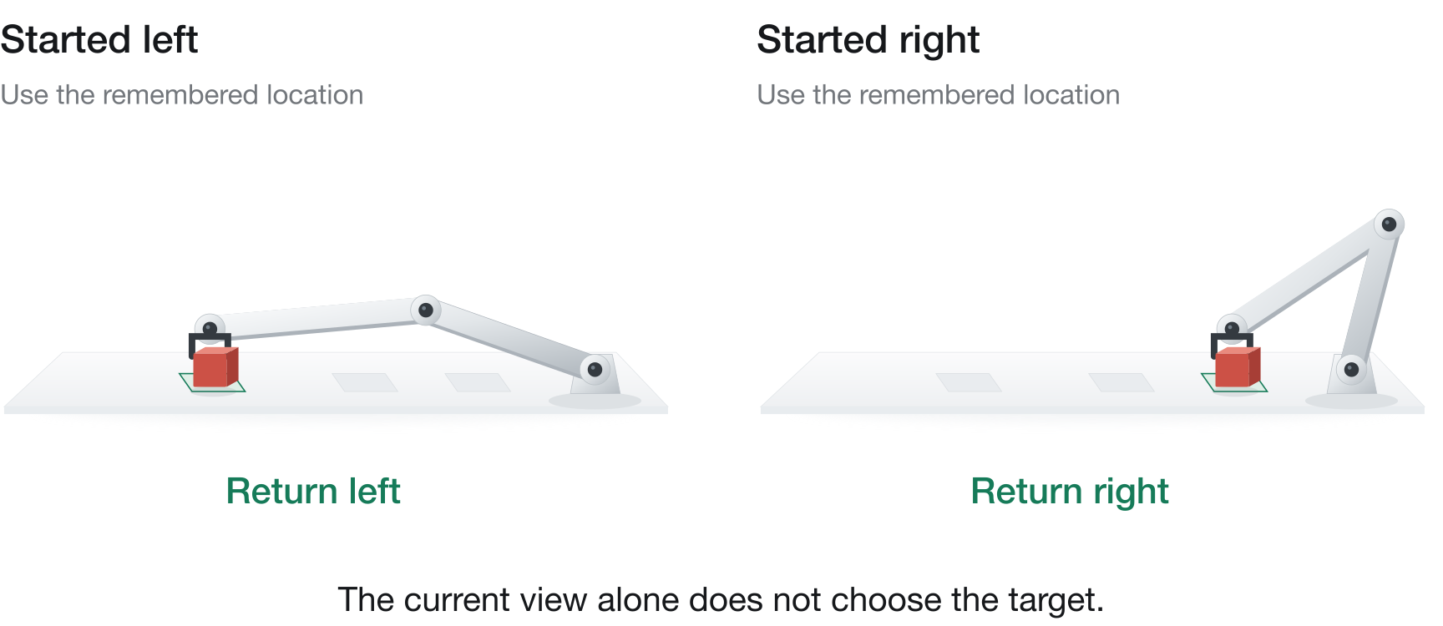
The same view can need different actions

Slide 22
MemBodied keeps policy memory fast
Policy-cycle time
NativeMEM
Milliseconds
Compressed video history
VLA
MemBodied
Fixed-size associative state
VLA
Same A100 80 GB · Four tasks
200 episodes per policy

Slide 23
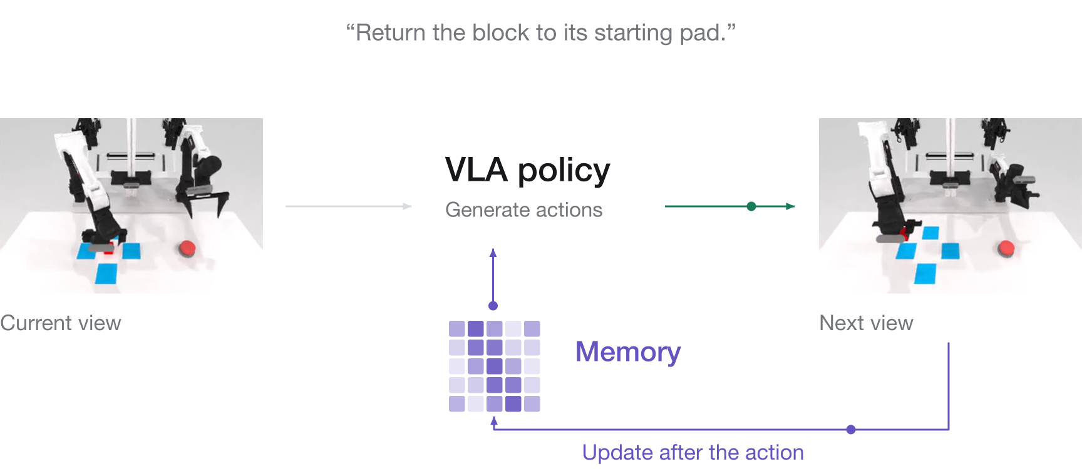
Memory carries history between calls

Slide 24
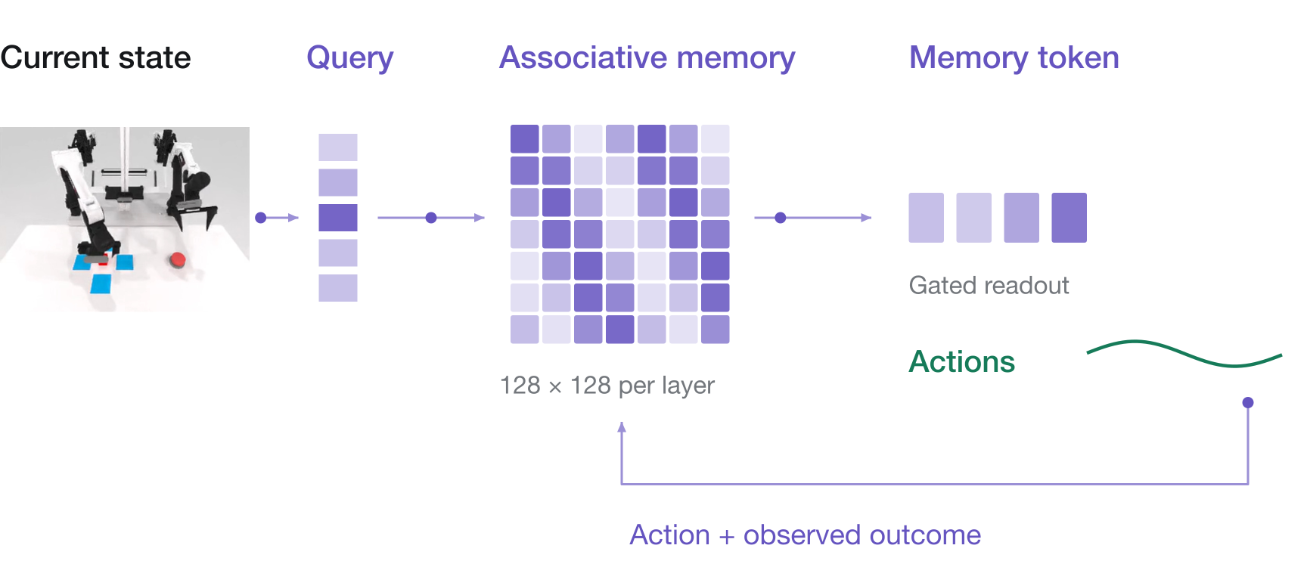
Reading and updating memory

Slide 25
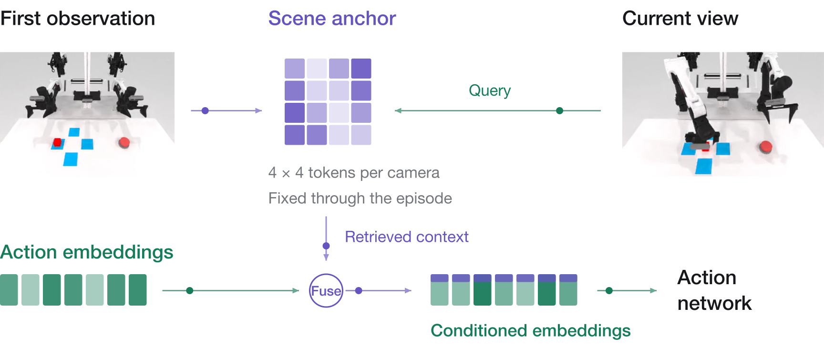
The starting scene conditions each action

Slide 26
Results on tasks that require memory
Task success (%)

Slide 27
MemBodied on real robots
Task success (%)

Slide 28
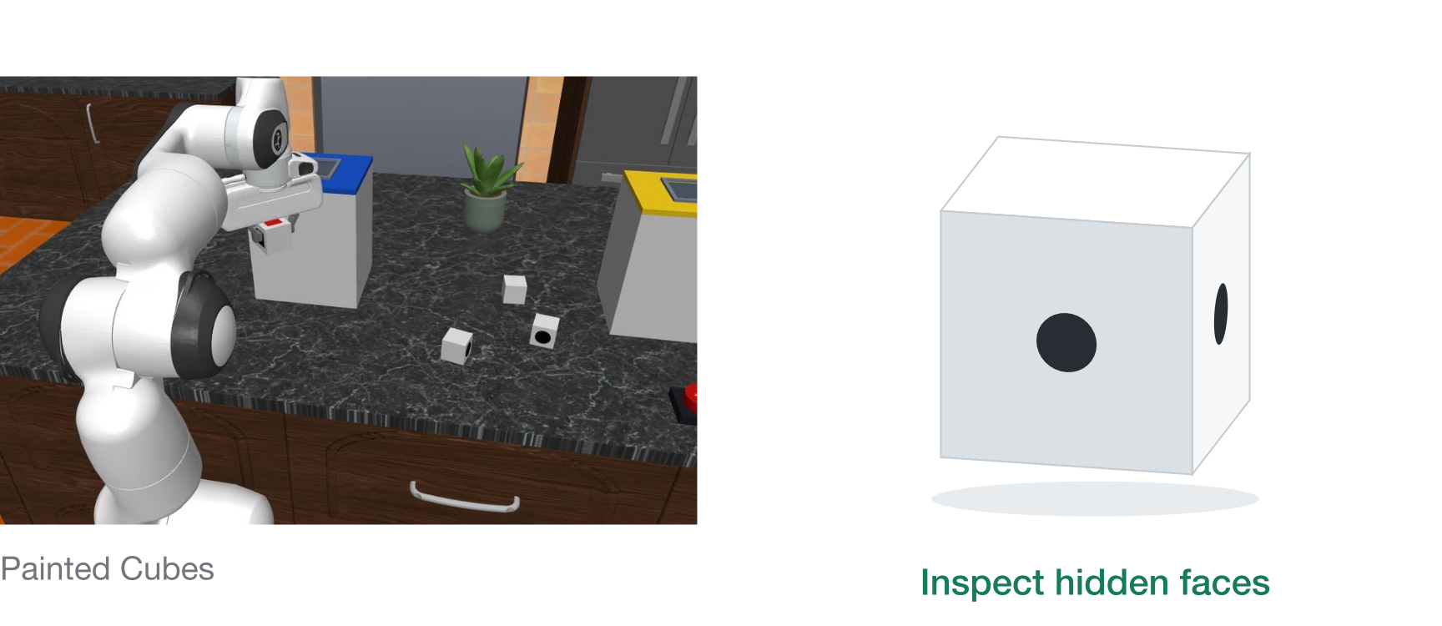
Some evidence has to be gathered

Slide 29
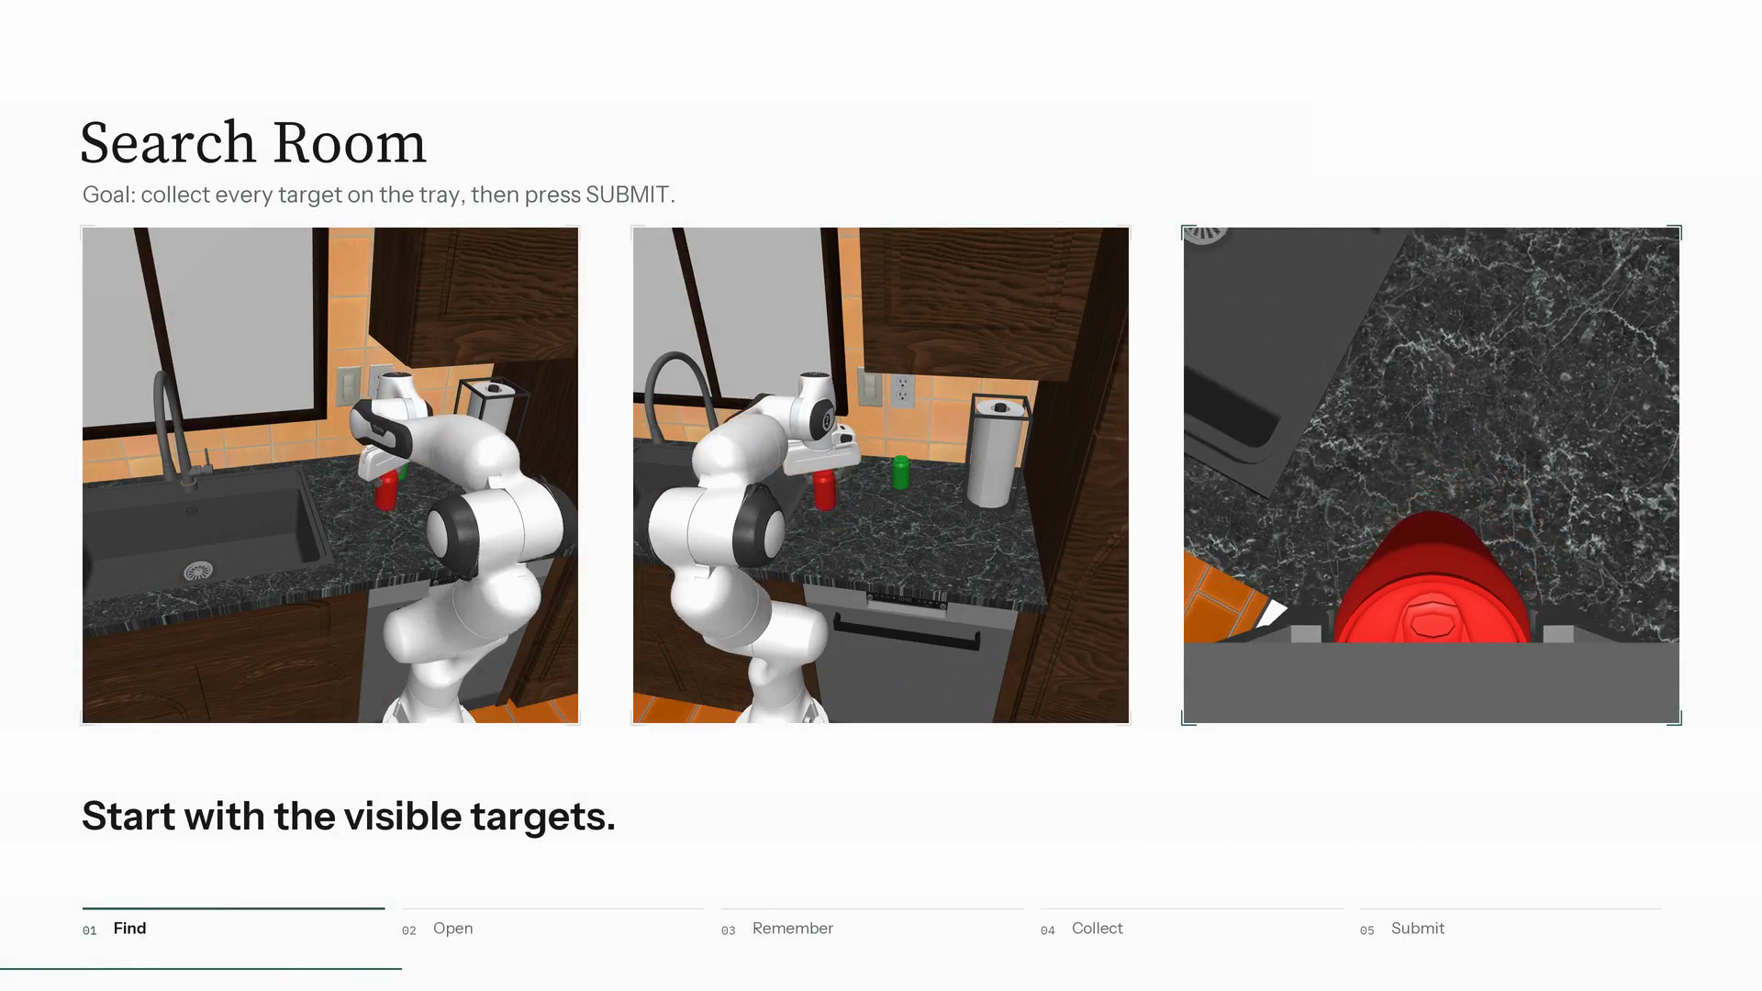

Slide 30
RoboQuest requires evidence seeking
The robot must act to uncover facts the task needs.
● Explicit target ◐ Partly — Not targeted
Benchmark | Long horizon | Hidden information | Memory | Mobile | Search | Inspect | Test
RLBench | ◐ | ◐ | — | — | — | — | —
ManiSkill3 | ◐ | — | — | — | — | — | —
RoboTwin 2.0 | ◐ | — | — | — | — | ◐ | —
LIBERO | ● | — | — | — | — | — | —
CALVIN | ● | ◐ | — | — | — | — | —
BEHAVIOR-1K | ● | ◐ | ◐ | ● | ● | — | —
RoboCasa365 | ● | — | ● | ● | ◐ | ◐ | ◐
RMBench | ● | ● | ● | — | — | — | ●
RoboQuest | ● | ● | ● | ● | ● | ● | ●
5,000 demonstrations of search, inspection and tests

Slide 31
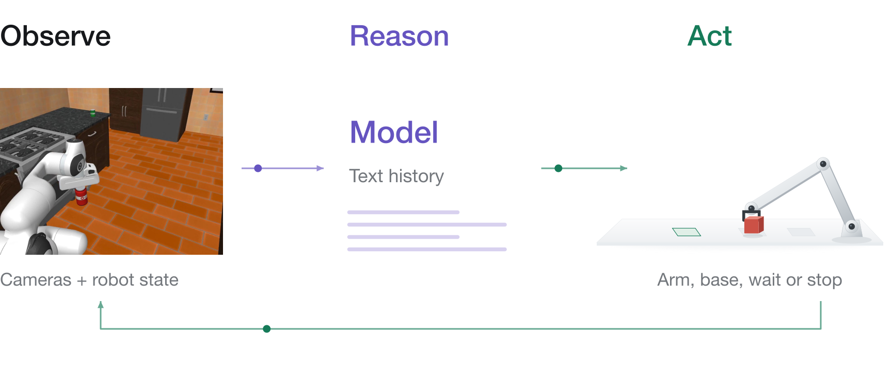
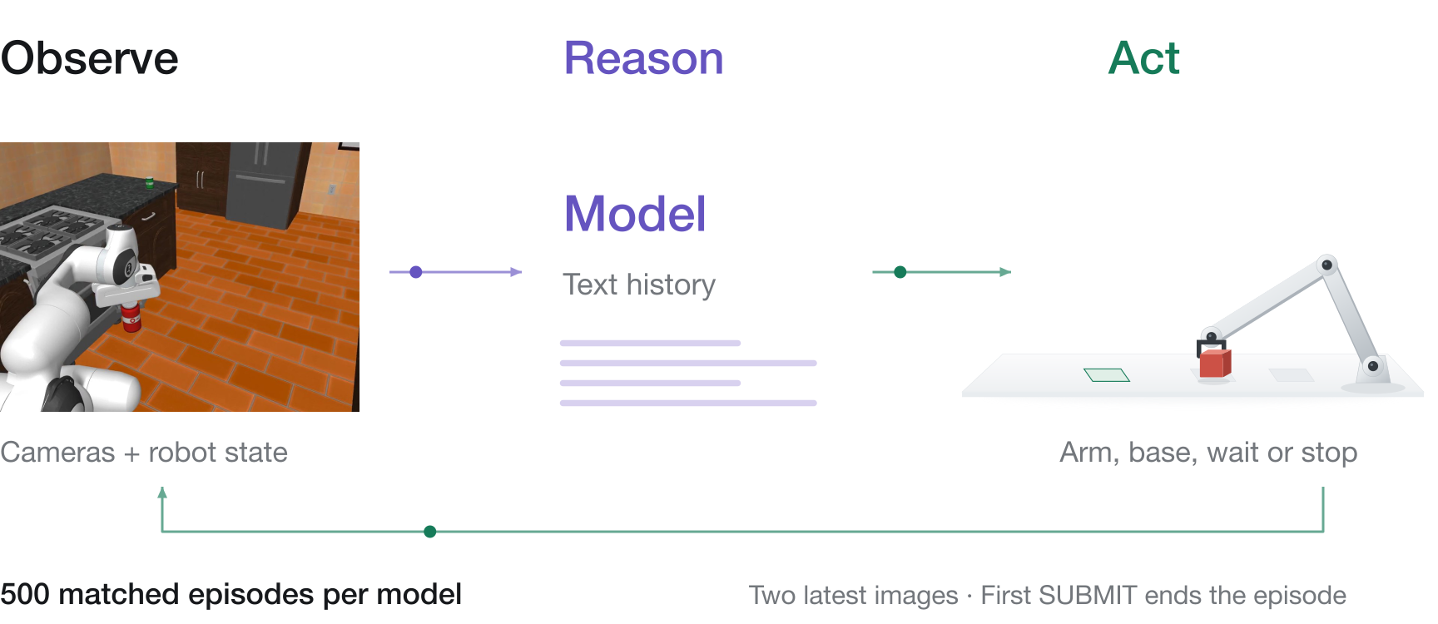
RoboQuest tests the full decision loop

Slide 32
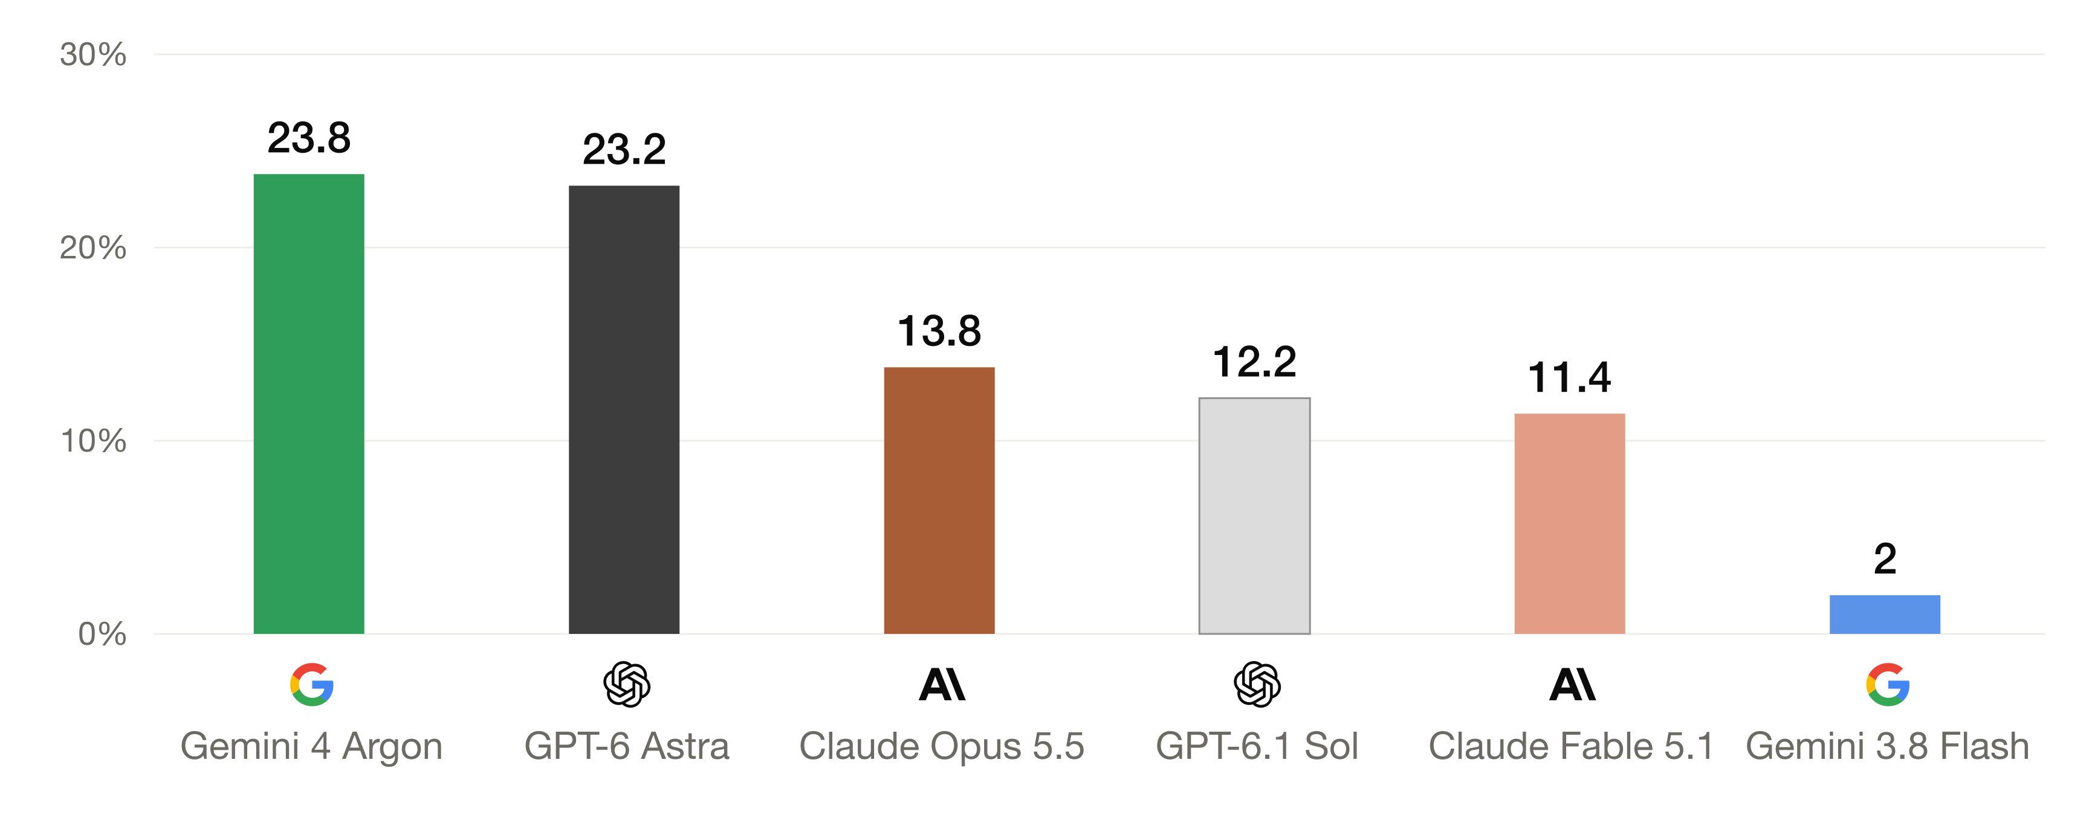
RoboQuest task success
Task success (%)

Slide 33
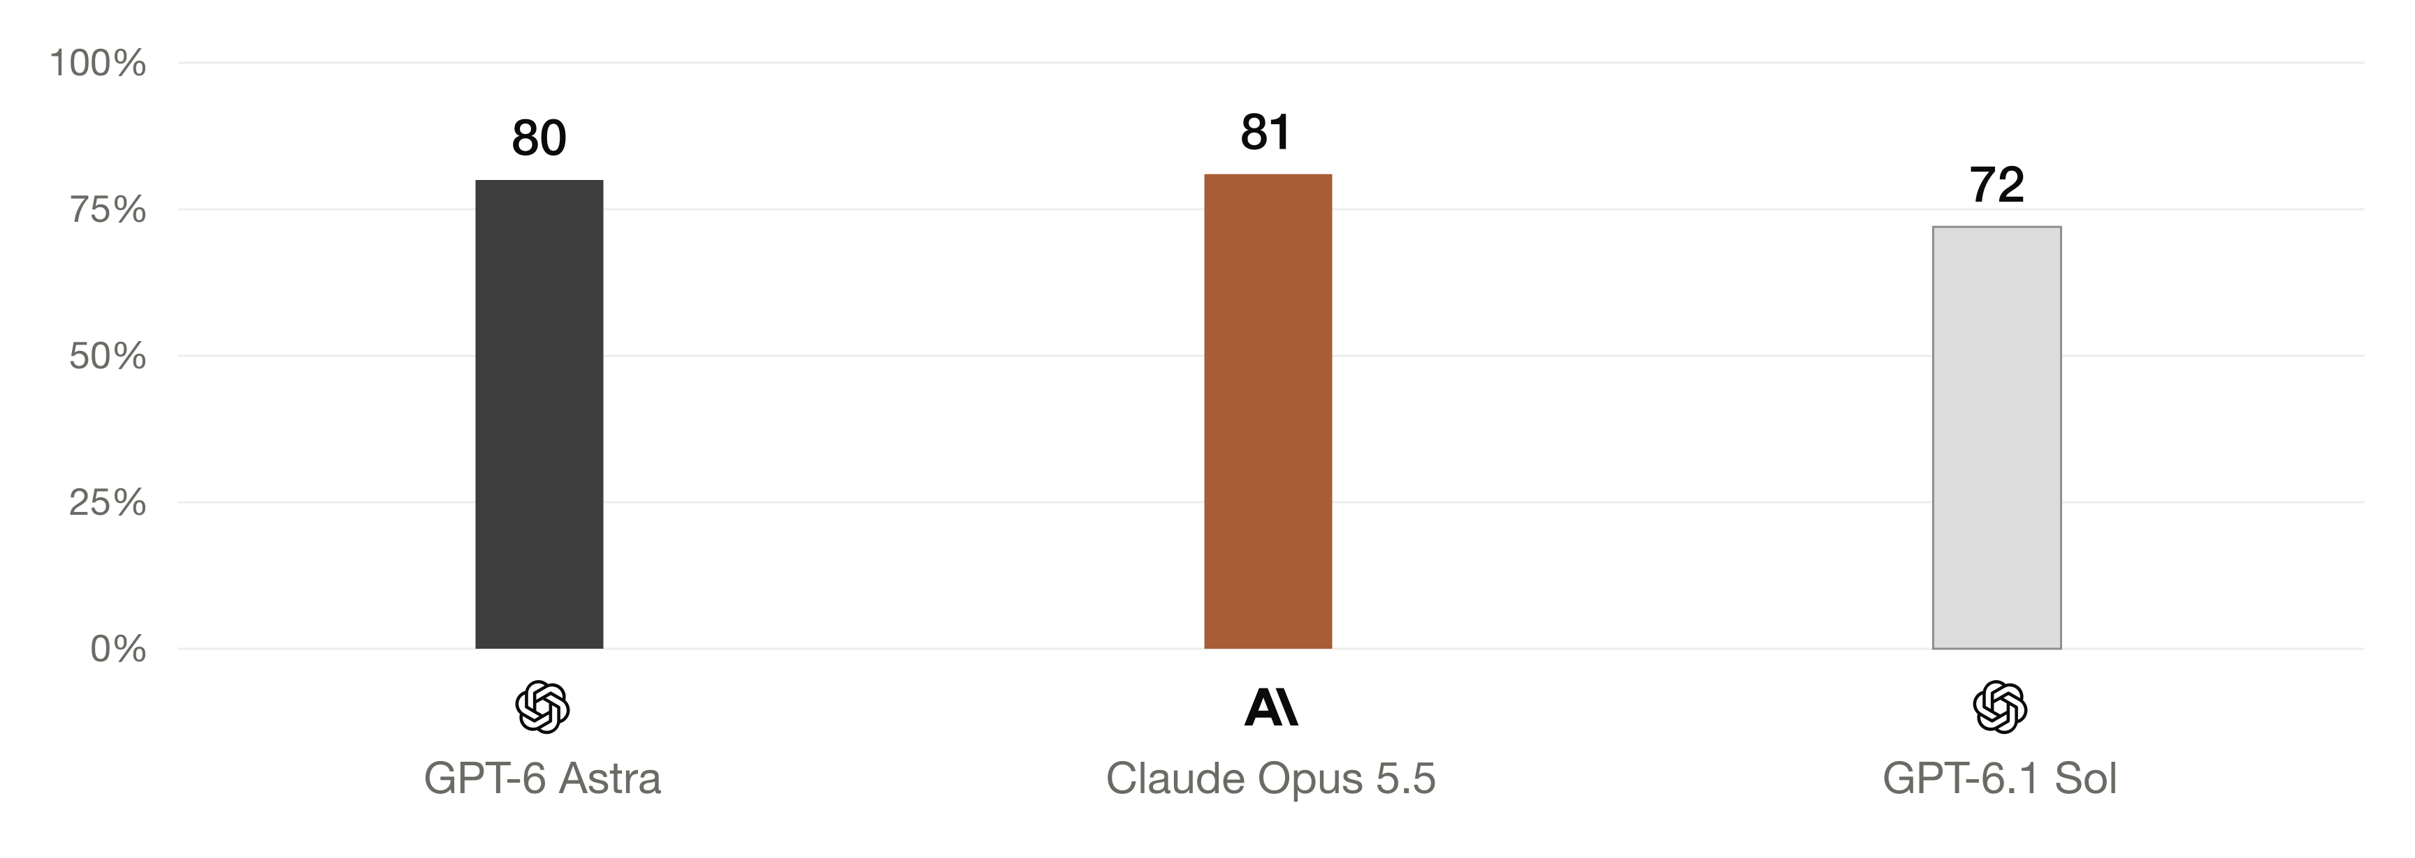
Execution skills in isolation
Success with oracle guidance (%)

Slide 34
Where the decision loop fails
Missing evidence
Deciding evidence was never collected.
Wrong decision
The evidence was seen, but used incorrectly.
Side effect
An action disturbed another goal condition.
Execution failure
The intended physical action failed.

Slide 35
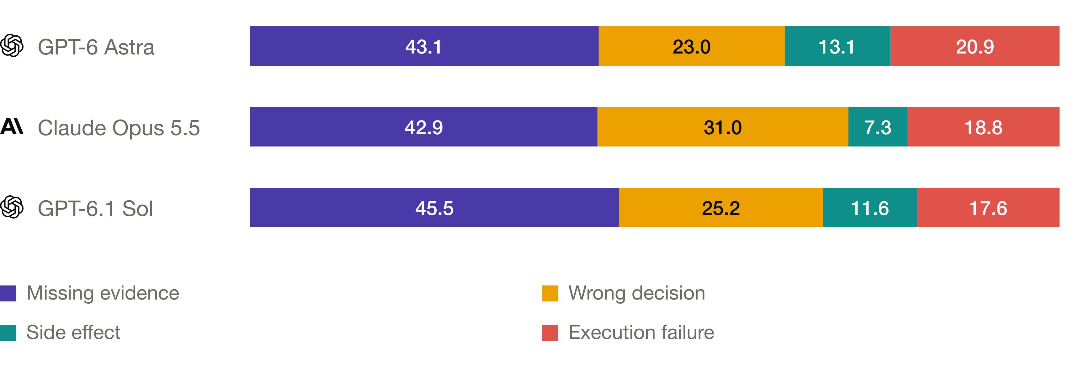
Failures by family
Share of failure attribution (%)
Missing evidence and wrong decisions: 66–74% of attribution

Slide 36
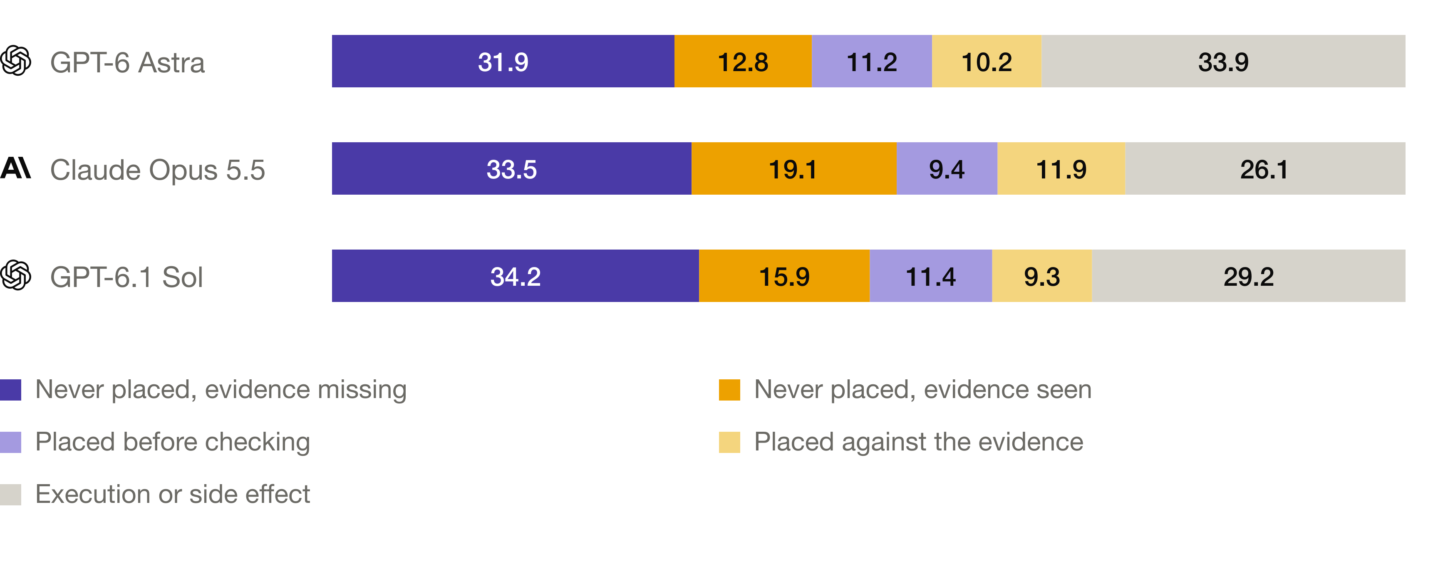
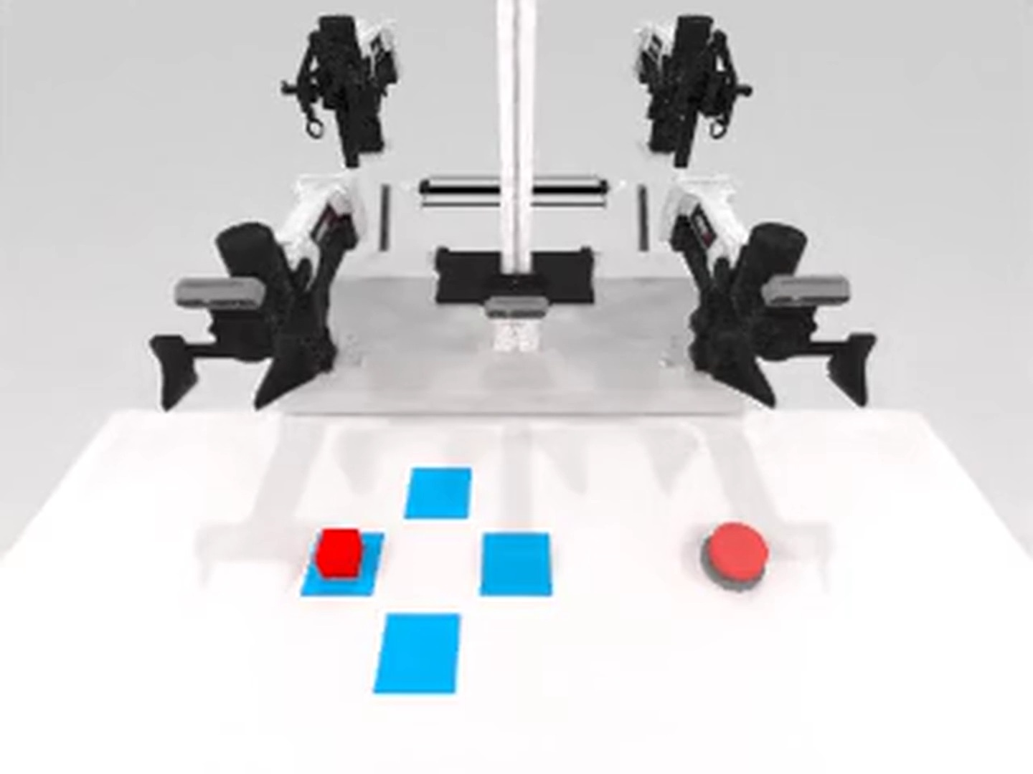
Exploration and object placement
Share of failures (%)

Slide 37
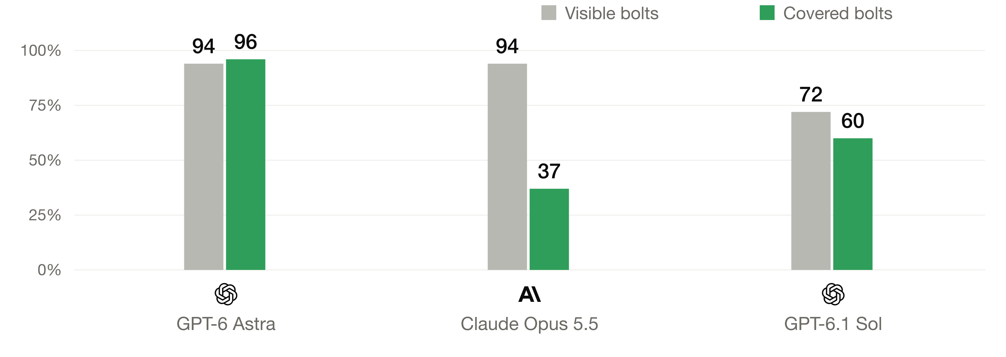
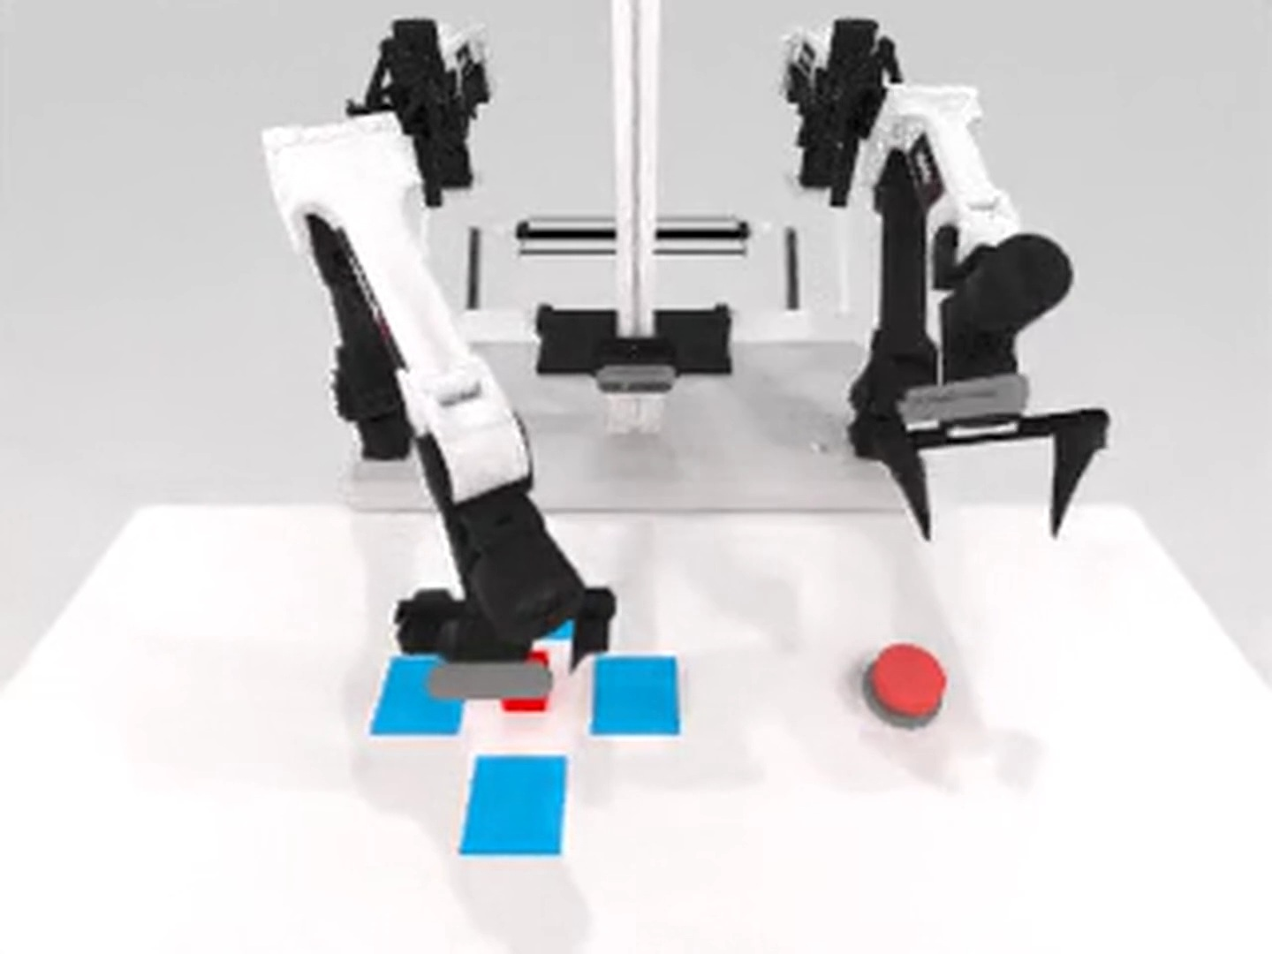
Puzzle Box with covered bolts
Puzzle Box success (%)

Slide 38
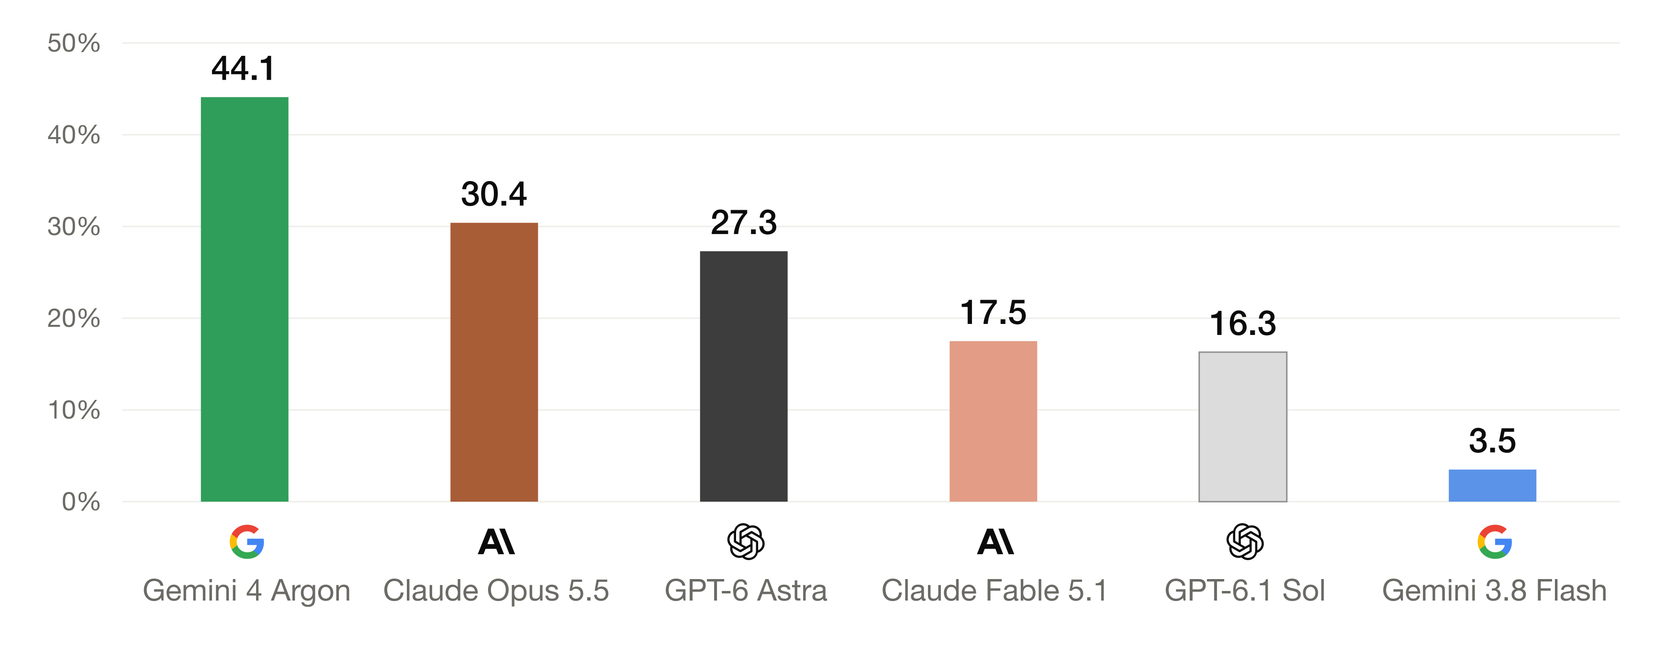
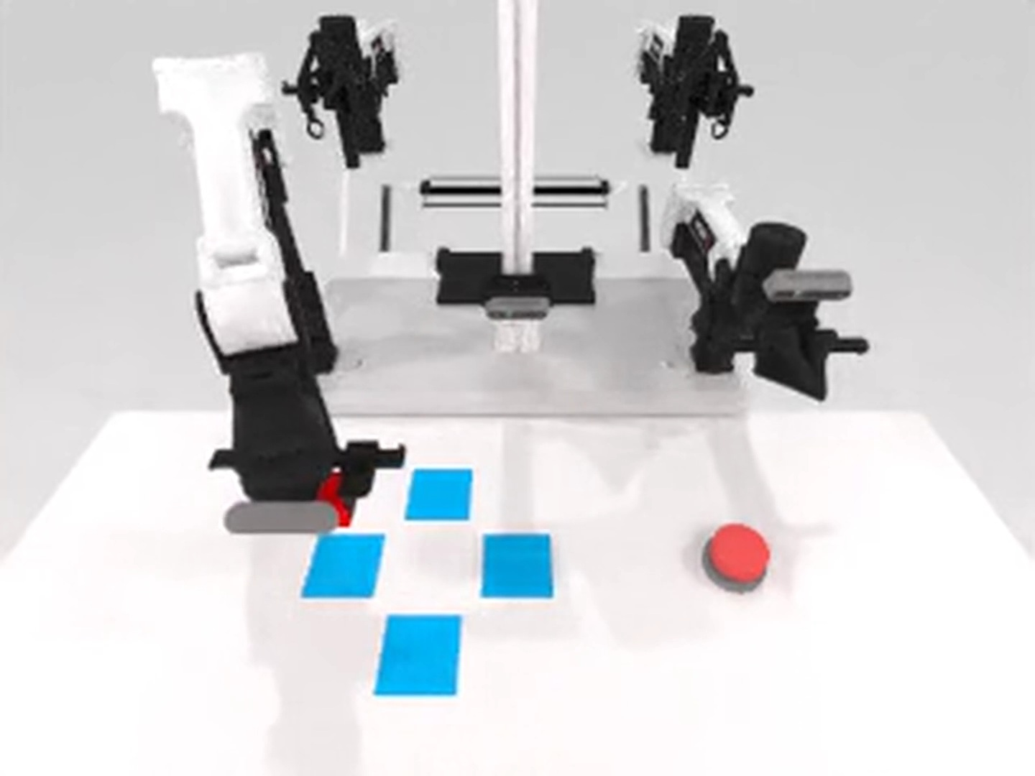
The harness needs a completion check
Correct submissions / all submissions (%)

Slide 39
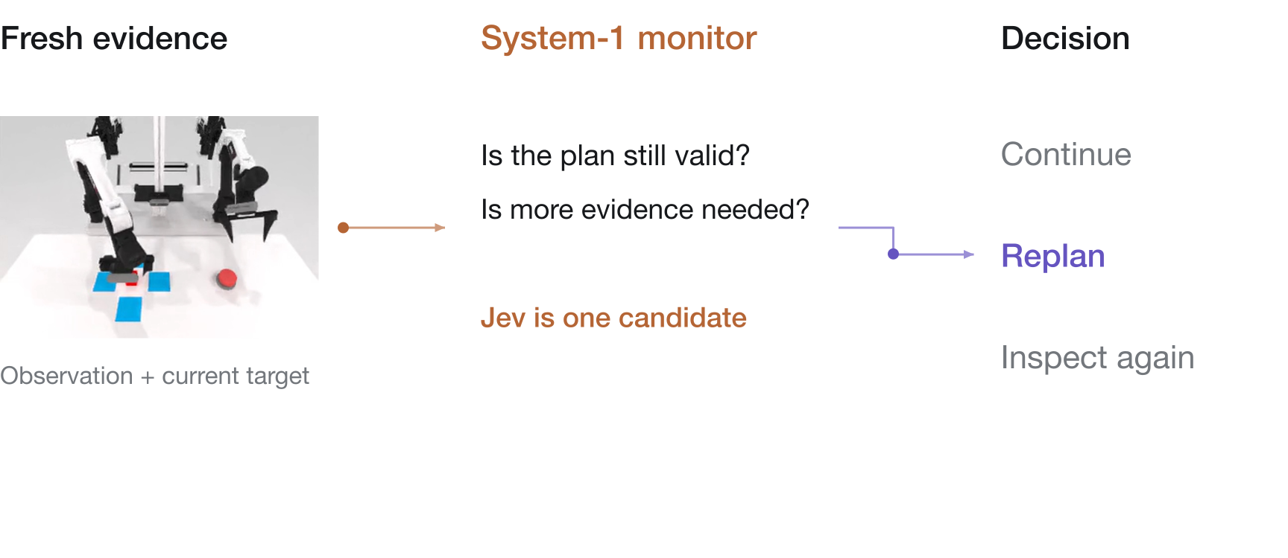
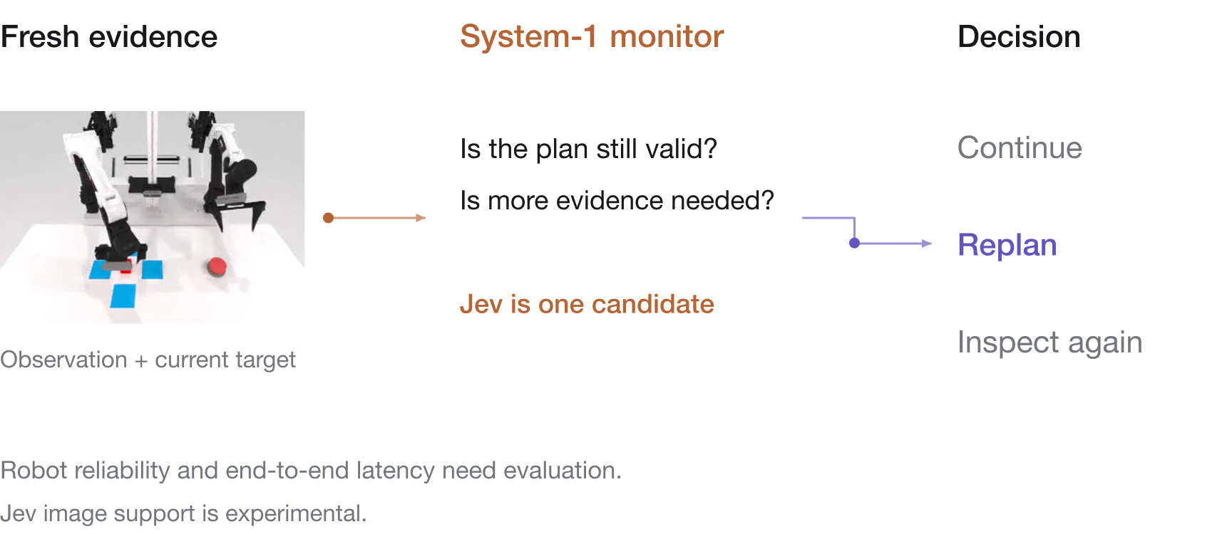
System-1 models could monitor execution

Slide 40
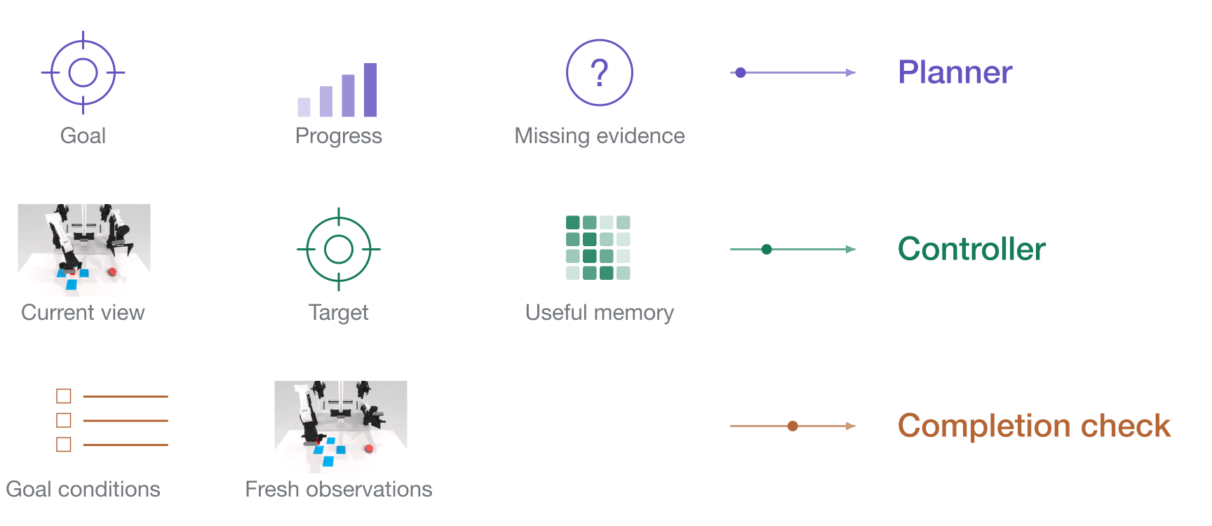
What should each model see?

Slide 41
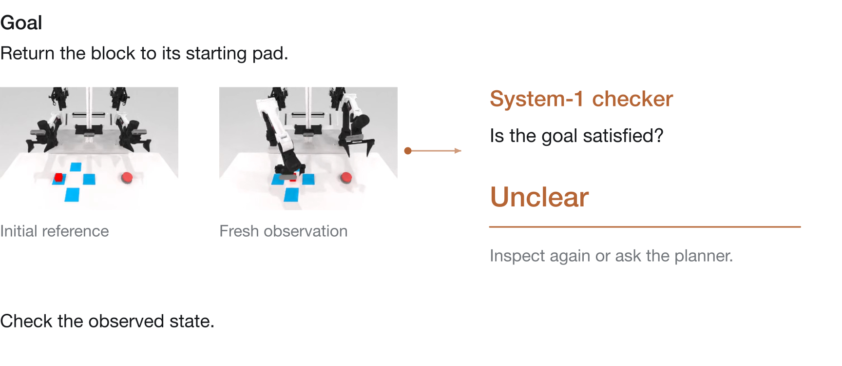
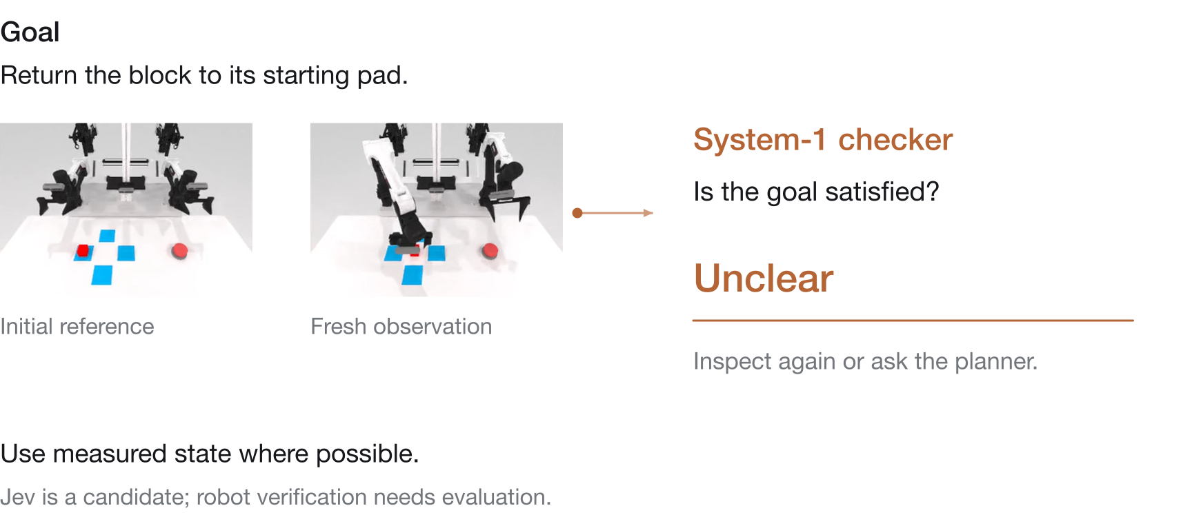
Completion checks need fresh evidence

Slide 42
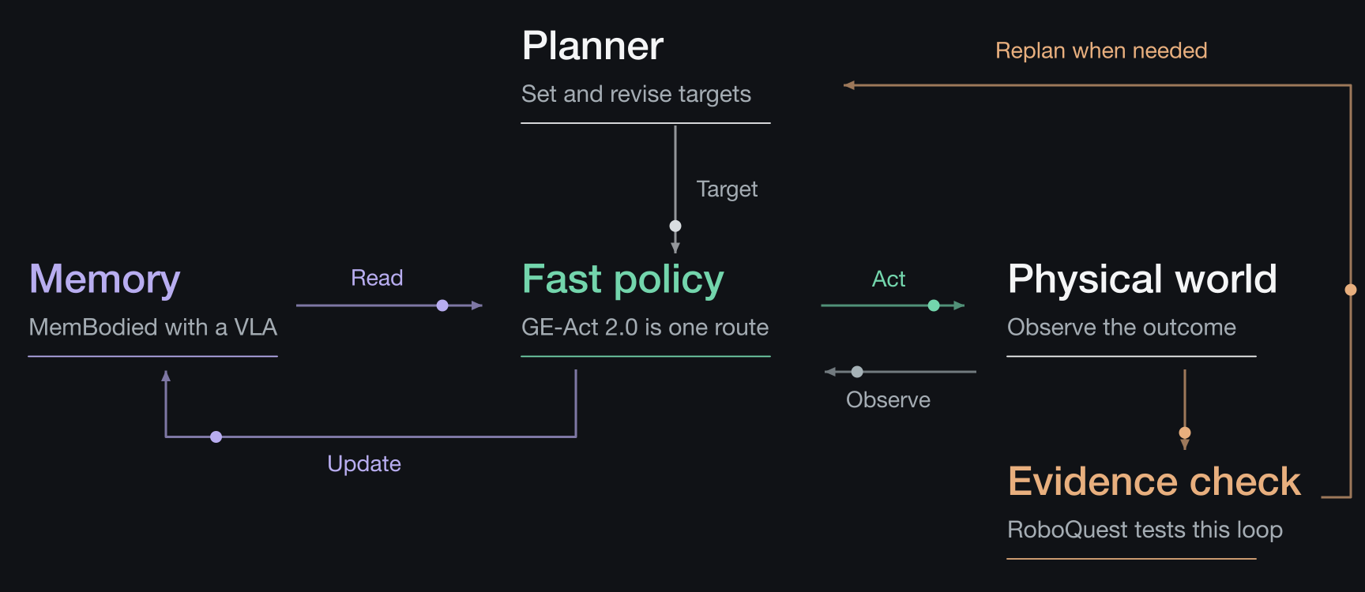
Toward a physical-agent harness

Slide 43
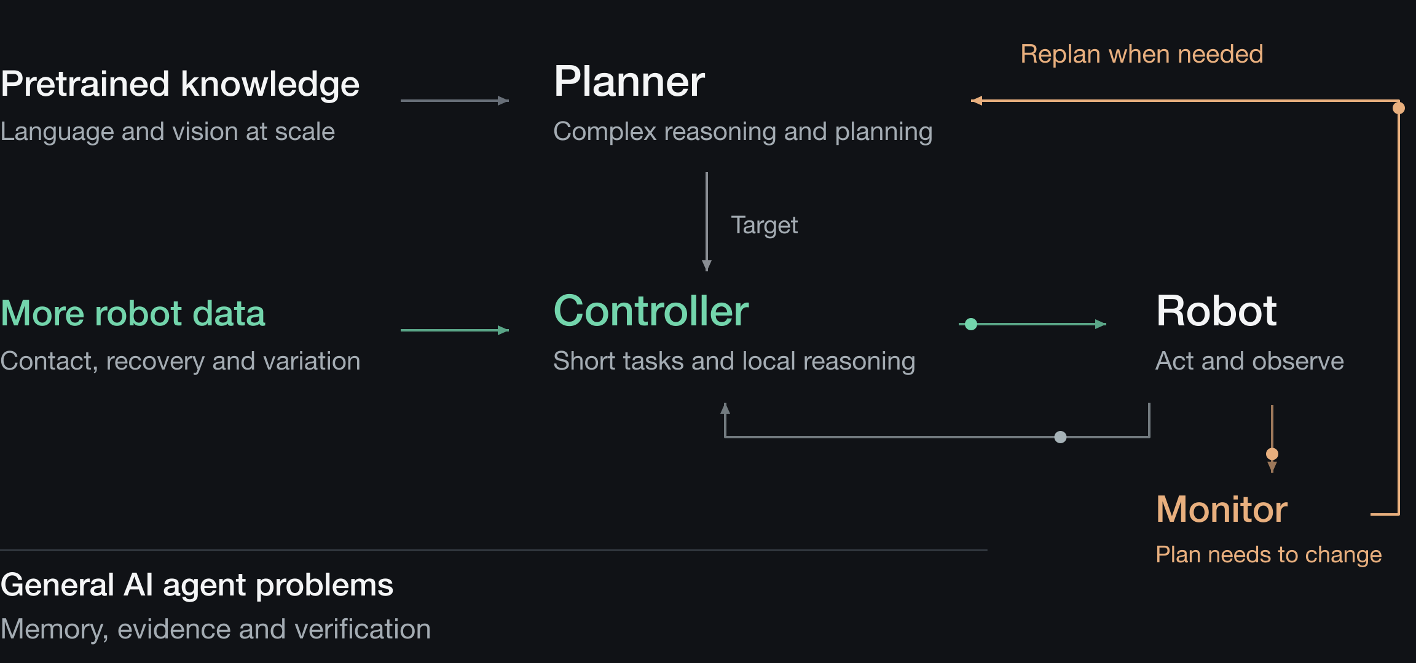
Physical AI needs more than robot data

Slide 44
References
GE-Act 2.0
SayCan
MemBodied
RT-2
RoboQuest
π₀.₅

